Slide 1

Being me in My World PSHE - Year 3

Slide 2

BMIMW – Year 3 Whole school charter

Slide 3
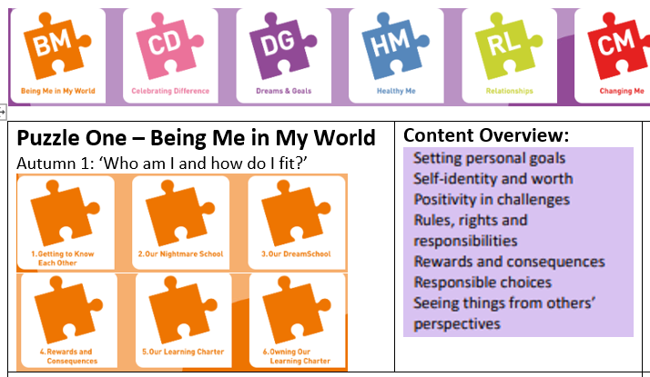
BMIMW – Year 3 Puzzle Pieces

Slide 4
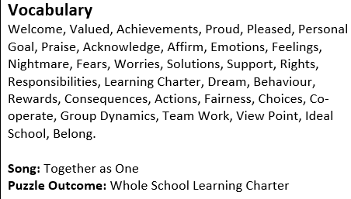
BMIMW – Year 5 Vocabulary

Slide 5
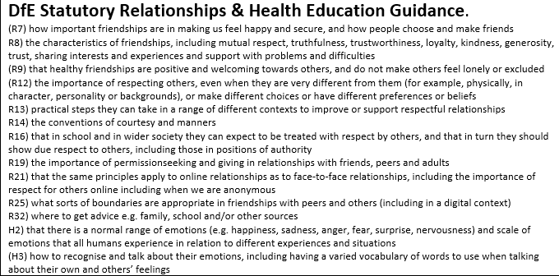
BMIMW – Year 3 Links to…

Slide 6
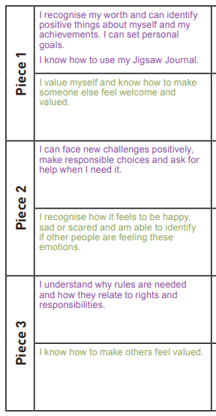
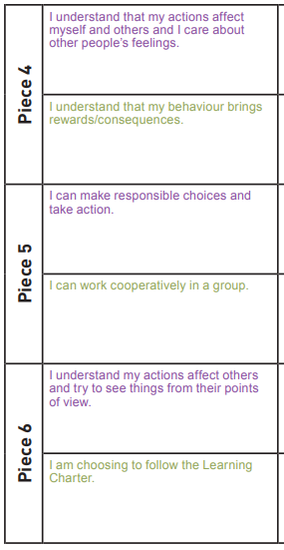
BMIMW – Year 3 LOs

Slide 7
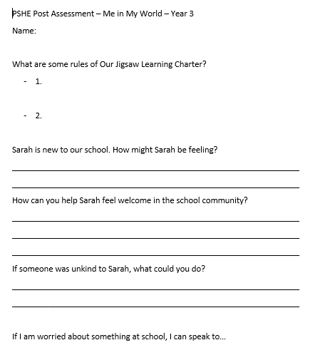
BMIMW – Year 3 Post Assessment

