Slide 1

Celebrating Difference PSHE - Year 3

Slide 2

CD – Year 3 Whole school charter

Slide 3
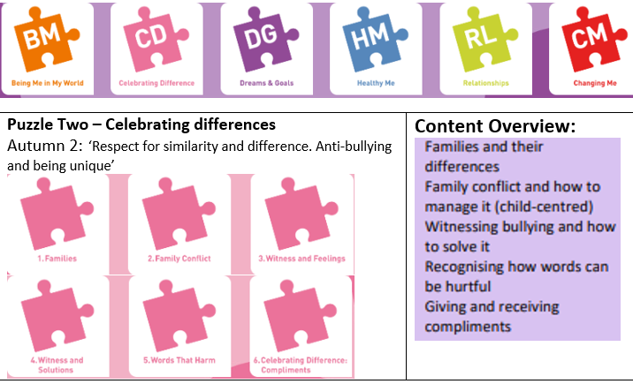
CD – Year 3 Puzzle Pieces

Slide 4
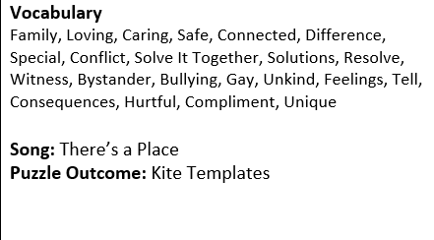
CD – Year 3 Vocabulary

Slide 5
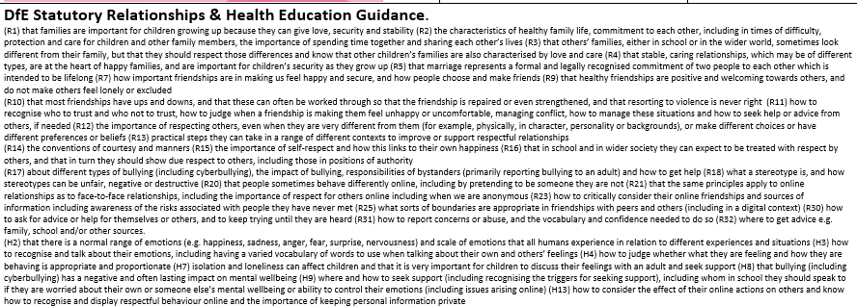
CD – Year 3 Links to…

Slide 6
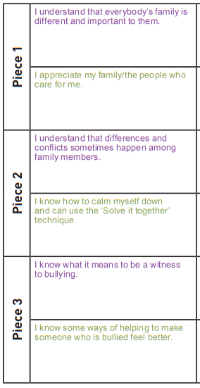
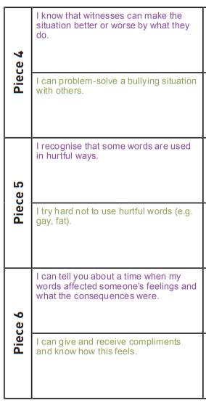
CD – Year 3 LOs

Slide 7
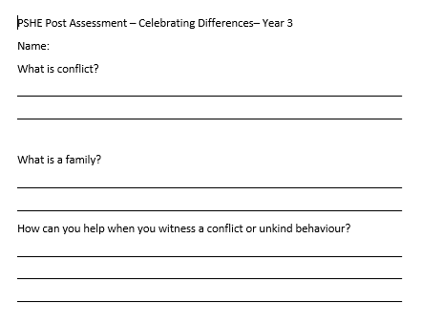
CD – Year 3 Post Assessment

