Slide 1

Dreams and
Goals
PSHE - Year 3

Slide 2

DAG – Year 3 Whole school charter

Slide 3
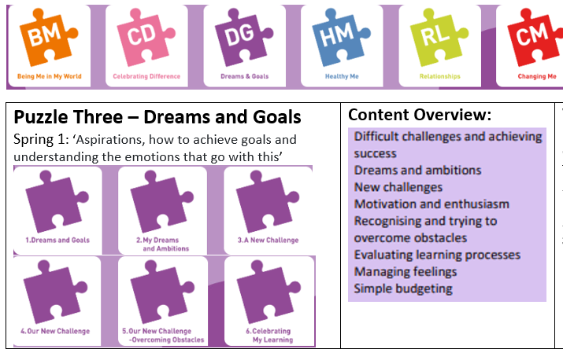
DAG – Year 3 Puzzle Pieces

Slide 4
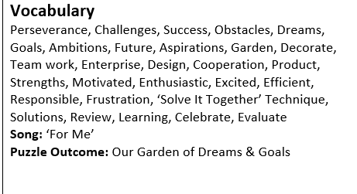
DAG – Year 3 Vocabulary

Slide 5
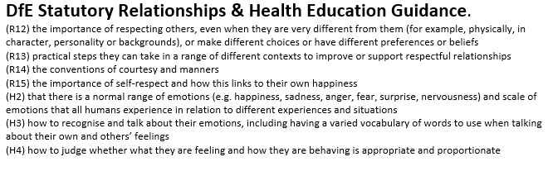
DAG – Year 3 Links to…

Slide 6
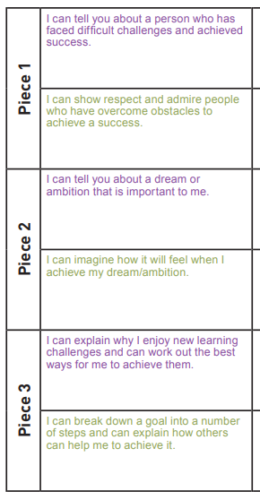
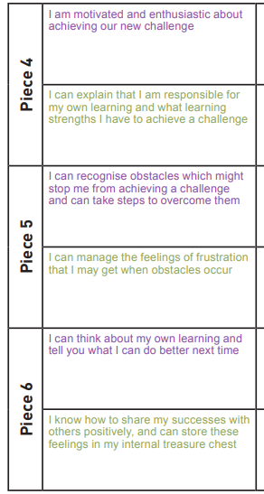
DAG – Year 3 LOs

Slide 7
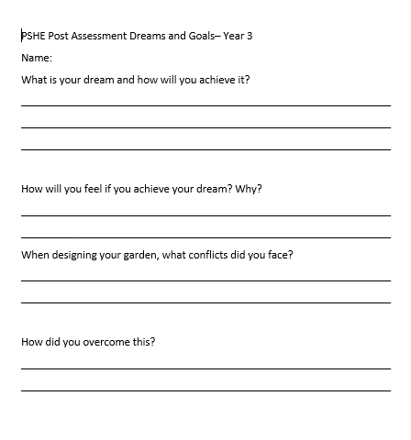
DAG – Year 3 Post Assessment

