Slide 1

Healthy
Me
PSHE - Year 3

Slide 2

HM – Year 3 Whole school charter

Slide 3

HM – Year 3 Puzzle Pieces

Slide 4
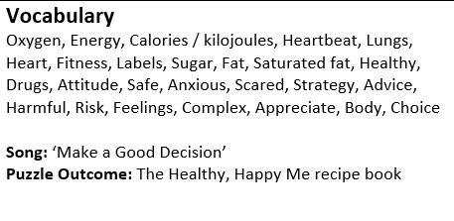
HM – Year 3 Vocabulary

Slide 5
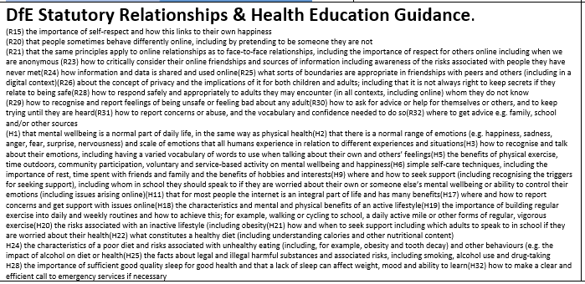
HM – Year 3 Links to…

Slide 6
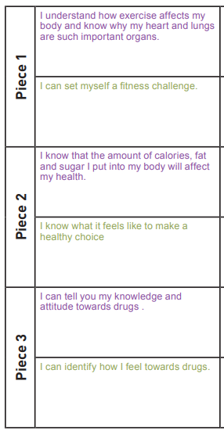
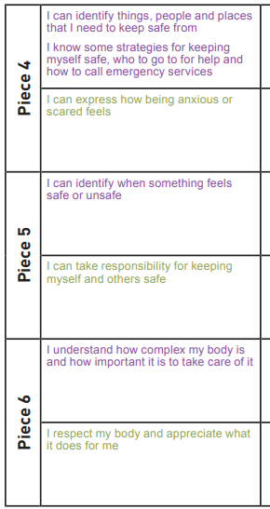
HM – Year 3 LOs

Slide 7
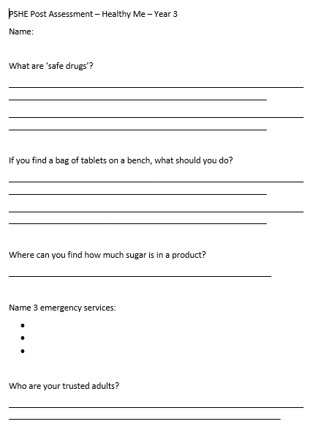
HM – Year 3 Post Assessment

