Slide 1

Relationships
PSHE - Year 3

Slide 2

Relationships – Year 3 Whole school charter

Slide 3
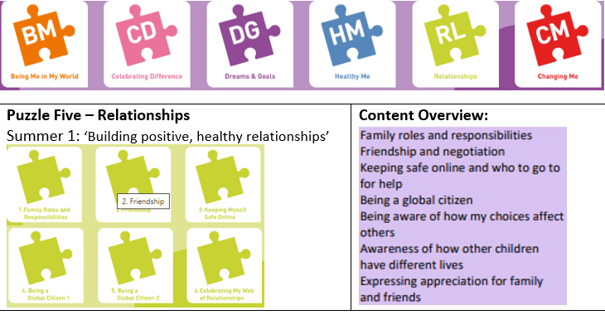
Relationships – Year 3 Puzzle Pieces

Slide 4
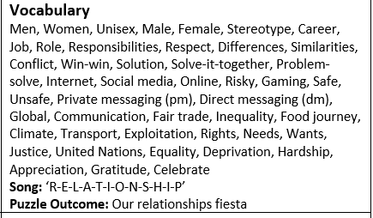
Relationships – Year 3 Vocabulary

Slide 5
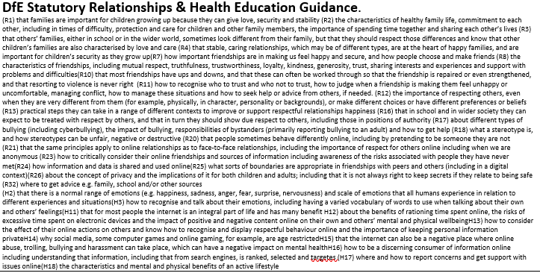
Relationships – Year 3 Links to…

Slide 6
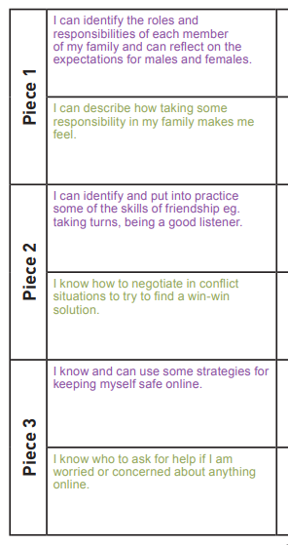
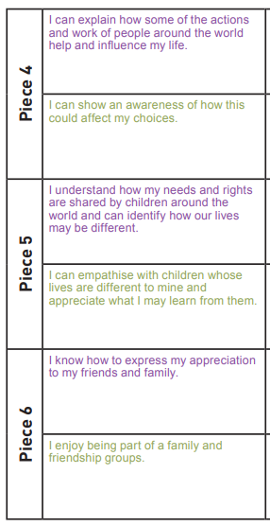
Relationships – Year 3 LOs

Slide 7
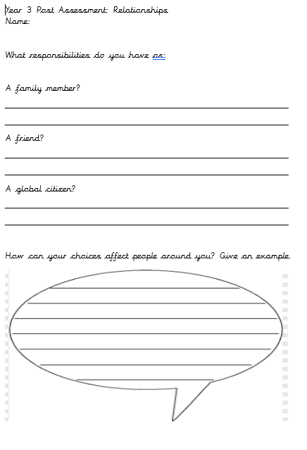
Relationships – Year 3 Post Assessment

