Slide 1

Changing Me
PSHE - Year 3

Slide 2

CM – Year 3 Whole school charter

Slide 3
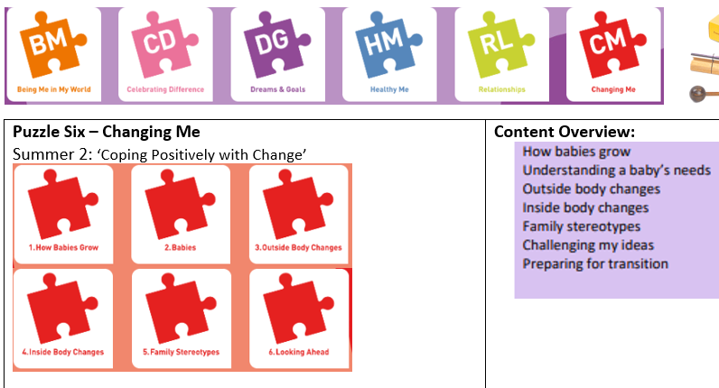
CM – Year 3 Puzzle Pieces

Slide 4
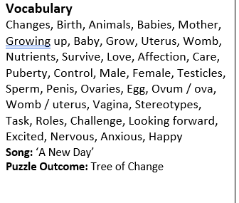
CM – Year 3 Vocabulary

Slide 5
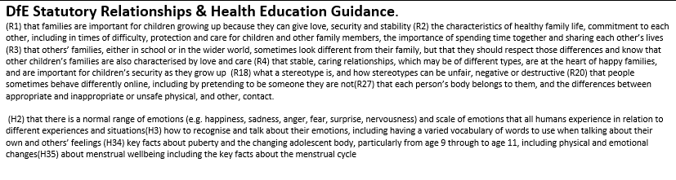
CM – Year 3 Links to…

Slide 6
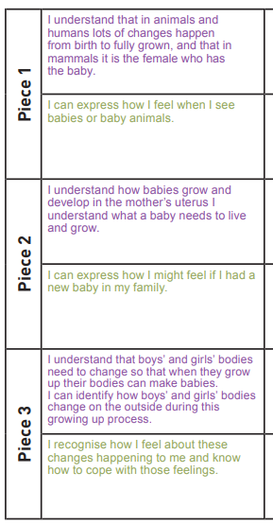
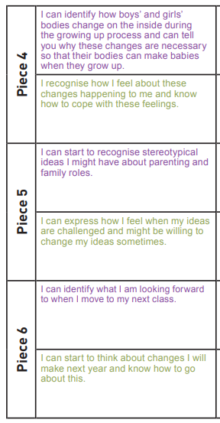
CM – Year 3 LOs

Slide 7
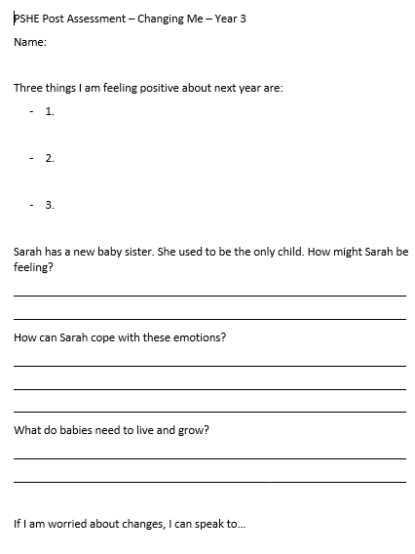
CM – Year 3 Post Assessment

