Slide 1
Being me in My World PSHE - Year 4

Slide 2

BMIMW – Year 4 Whole school charter

Slide 3

BMIMW – Year 4 Puzzle Pieces

Slide 4
BMIMW – Year 4 Vocabulary
Vocabulary
Included, Excluded, Welcome, Valued, Team, Charter, Role, Job Description, School Community, Responsibility, Rights, Democracy, Democratic, Reward, Consequence, Decisions, Voting, Authority, Learning Charter, Contribution, Observer, UN Convention on Rights of Child (UNCRC).
Song: Together as One
Puzzle Outcome: Whole School Learning Charter

Slide 5
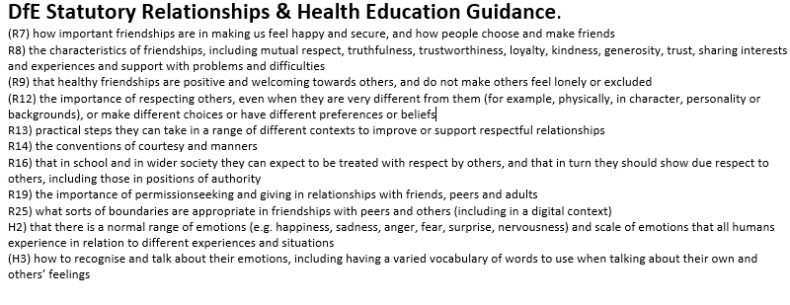
BMIMW – Year 4 Links to…

Slide 6
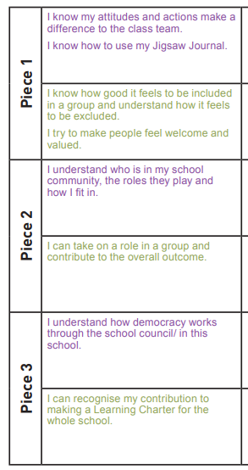
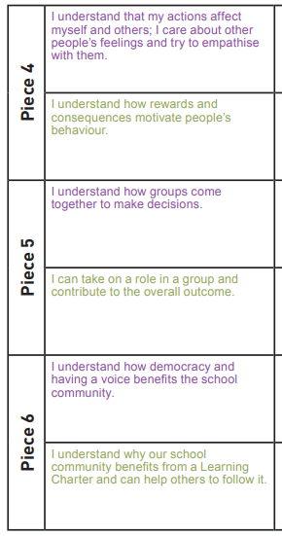
BMIMW – Year 4 LOs

Slide 7
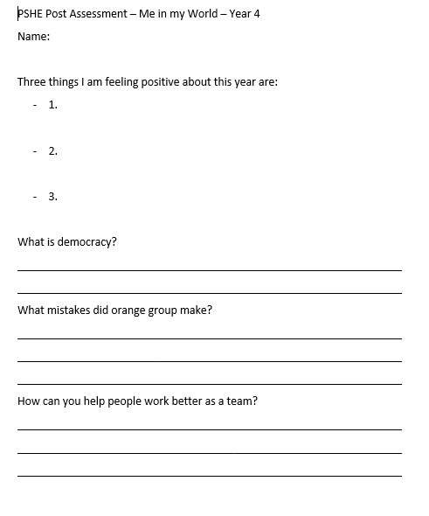
BMIMW – Year 4 Post Assessment

