Slide 1
Dreams and
Goals
PSHE - Year 4

Slide 2

DAG – Year 4 Whole school charter

Slide 3
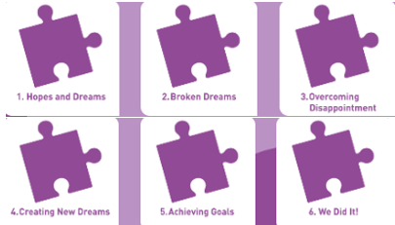
DAG – Year 4 Puzzle Pieces

Slide 4
DAG – Year 4 Vocabulary
Vocabulary
Dream, Hope, Goal, Determination, Perseverance, Resilience, Positive attitude, Disappointment, Fears, Hurts, Positive experiences, Plans, Cope, Help, Self-belief, Motivation, Commitment, Enterprise, Design, Cooperation, Success, Celebrate, Evaluate
Song: ‘For Me’
Puzzle Outcome: Our Garden of Dreams & Goals

Slide 5
DAG – Year 4 Links to…
DfE Statutory Relationships & Health Education Guidance.
(R12) the importance of respecting others, even when they are very different from them (for example, physically, in character, personality or backgrounds), or make different choices or have different preferences or beliefs
(R14) the conventions of courtesy and manners
(R15) the importance of self-respect and how this links to their own happiness
(R16) that in school and in wider society they can expect to be treated with respect by others, and that in turn they should show due respect to others, including those in positions of authority
(H2) that there is a normal range of emotions (e.g. happiness, sadness, anger, fear, surprise, nervousness) and scale of emotions that all humans experience in relation to different experiences and situations
(H3) how to recognise and talk about their emotions, including having a varied vocabulary of words to use when talking about their own and others’ feelings

Slide 6
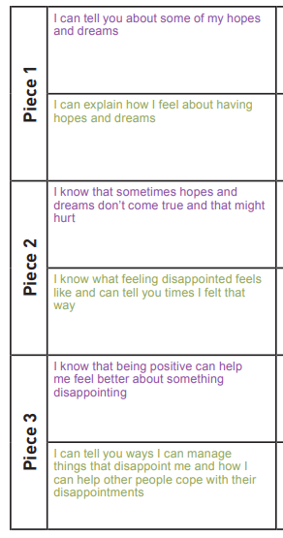
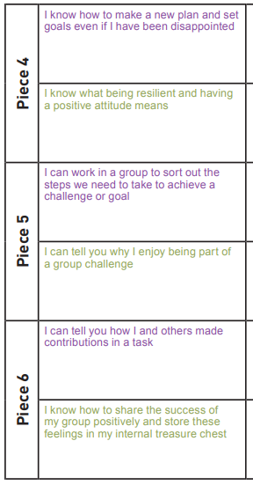
DAG – Year 4 LOs

Slide 7
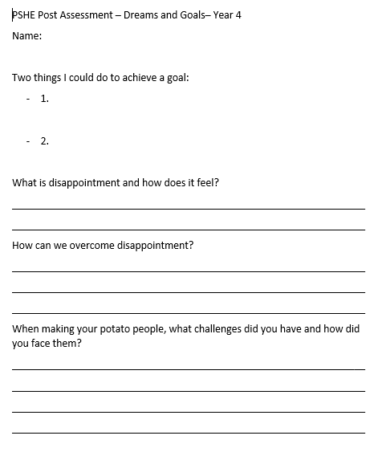
DAG – Year 4 Post Assessment

