Slide 1
Healthy
Me
PSHE - Year 4

Slide 2

HM – Year 4 Whole school charter

Slide 3
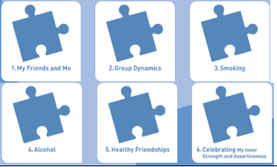
HM – Year 4 Puzzle Pieces

Slide 4
HM – Year 4 Vocabulary
Vocabulary
Friendship, Emotions, Healthy, Relationships, Friendship groups, Value, Roles, Leader, Follower, Assertive, Agree, Disagree, Smoking, Pressure, Peers, Guilt, Advice, Alcohol, Liver, Disease, Anxiety, Fear, Believe, Assertive, Opinion, Right, Wrong.
Song: ‘Make a Good Decision’
Puzzle Outcome: The Healthy, Happy Me recipe book

Slide 5
HM – Year 4 Links to…
DfE Statutory Relationships & Health Education Guidance.
(R7) how important friendships are in making us feel happy and secure, and how people choose and make friends
R8) the characteristics of friendships, including mutual respect, truthfulness, trustworthiness, loyalty, kindness, generosity, trust, sharing interests and experiences and support with problems and difficulties (R9) that healthy friendships are positive and welcoming towards others, and do not make others feel lonely or excluded (R10) that most friendships have ups and downs, and that these can often be worked through so that the friendship is repaired or even strengthened, and that resorting to violence is never right (R11) how to recognise who to trust and who not to trust, how to judge when a friendship is making them feel unhappy or uncomfortable, managing conflict, how to manage these situations and how to seek help or advice from others, if needed.
needed (R12) the importance of respecting others, even when they are very different from them (for example, physically, in character, personality or backgrounds), or make different choices or have different preferences or beliefs (R13) practical steps they can take in a range of different contexts to improve or support respectful relationships (R15) the importance of self-respect and how this links to their own happiness (R16) that in school and in wider society they can expect to be treated with respect by others, and that in turn they should show due respect to others, including those in positions of authority
(R20) that people sometimes behave differently online, including by pretending to be someone they are not
(R21) that the same principles apply to online relationships as to face-to-face relationships, including the importance of respect for others online including when we are anonymous (R25) what sorts of boundaries are appropriate in friendships with peers and others (including in a digital context)(R26) about the concept of privacy and the implications of it for both children and adults; including that it is not always right to keep secrets if they relate to being safe(R28) how to respond safely and appropriately to adults they may encounter (in all contexts, including online) whom they do not know (R29) how to recognise and report feelings of being unsafe or feeling bad about any adult(R30) how to ask for advice or help for themselves or others, and to keep trying until they are heard(R31) how to report concerns or abuse, and the vocabulary and confidence needed to do so(R32) where to get advice e.g. family, school and/or other sources
(H1) that mental wellbeing is a normal part of daily life, in the same way as physical health(H2) that there is a normal range of emotions (e.g. happiness, sadness, anger, fear, surprise, nervousness) and scale of emotions that all humans experience in relation to different experiences and situations(H3) how to recognise and talk about their emotions, including having a varied vocabulary of words to use when talking about their own and others’ feelings H4) how to judge whether what they are feeling and how they are behaving is appropriate and (H11) that for most people the internet is an integral part of life and has many benefits(H17) where and how to report concerns and get support with issues online (H21) how and when to seek support including which adults to speak to in school if they are worried about their health(H24) the characteristics of a poor diet and risks associated with unhealthy eating (including, for example, obesity and tooth decay) and other behaviours (e.g. the impact of alcohol on diet or health (H25) the facts about legal and illegal harmful substances and associated risks, including smoking, alcohol use and drug-taking H26) how to recognise early signs of physical illness, such as weight loss, or unexplained changes to the body

Slide 6
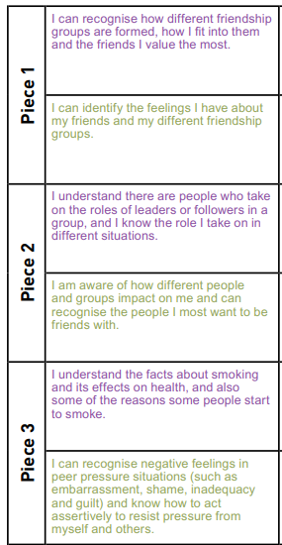
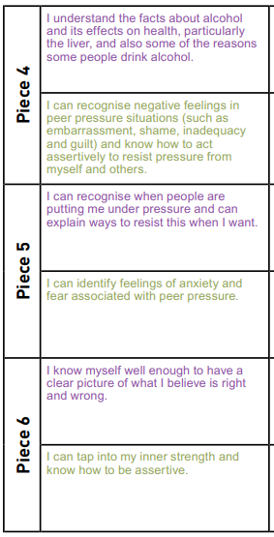
HM – Year 4 LOs

Slide 7
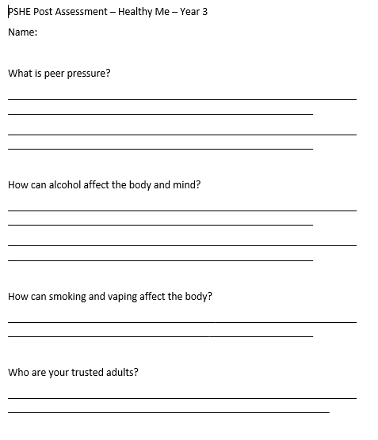
HM – Year 4 Post Assessment

