Slide 1
Relationships
PSHE - Year 4

Slide 2

Relationships – Year 4 Whole school charter

Slide 3
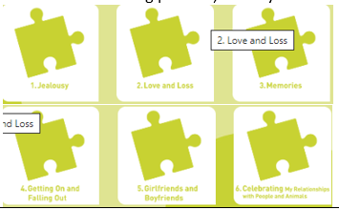
Relationships – Year 4 Puzzle Pieces

Slide 4
Relationships – Year 4 Vocabulary
Vocabulary
Relationship, Close, Jealousy, Problem-solve, Emotions, Positive, Negative, Loss, Shock, Disbelief, Numb, Denial, Anger, Guilt, Sadness, Pain, Despair, Hope, Souvenir, Memento, Memorial, Acceptance, Relief, Remember, Negotiate, Compromise, Trust, Loyal, Empathy, Betrayal, Amicable, Appreciation, Love.
Song: ‘R-E-L-A-T-I-O-N-S-H-I-P’
Puzzle Outcome: Our relationships fiesta

Slide 5
Relationships – Year 4 Links to…
DfE Statutory Relationships & Health Education Guidance.
(R2) the characteristics of healthy family life, commitment to each other, including in times of difficulty, protection and care for children and other family members, the importance of spending time together and sharing each other’s lives (R4) that stable, caring relationships, which may be of different types, are at the heart of happy families, and are important for children’s security as they grow up R6) how to recognise if family relationships are making them feel unhappy or unsafe, and how to seek help or advice from others if needed (R7) how important friendships are in making us feel happy and secure, and how people choose and make friends (R8) the characteristics of friendships, including mutual respect, truthfulness, trustworthiness, loyalty, kindness, generosity, trust, sharing interests and experiences and support with problems and difficulties(R10) that most friendships have ups and downs, and that these can often be worked through so that the friendship is repaired or even strengthened, and that resorting to violence is never right (R11) how to recognise who to trust and who not to trust, how to judge when a friendship is making them feel unhappy or uncomfortable, managing conflict, how to manage these situations and how to seek help or advice from others, if needed. (R12) the importance of respecting others, even when they are very different from them (for example, physically, in character, personality or backgrounds), or make different choices or have different preferences or beliefs (R13) practical steps they can take in a range of different contexts to improve or support respectful relationships happiness R14) the conventions of courtesy and manners (R16) that in school and in wider society they can expect to be treated with respect by others, and that in turn they should show due respect to others, including those in positions of authority R19) the importance of permission seeking and giving in relationships with friends, peers and adults (R25) what sorts of boundaries are appropriate in friendships with peers and others (including in a digital context) (R32) where to get advice e.g. family, school and/or other sources
(H2) that there is a normal range of emotions (e.g. happiness, sadness, anger, fear, surprise, nervousness) and scale of emotions that all humans experience in relation to different experiences and situations(H3) how to recognise and talk about their emotions, including having a varied vocabulary of words to use when talking about their own and others’ feelings (H4) how to judge whether what they are feeling and how they are behaving is appropriate and proportionate (H7) isolation and loneliness can affect children and that it is very important for children to discuss their feelings with an adult and seek H9) where and how to seek support (including recognising the triggers for seeking support), including whom in school they should speak to if they are worried about their own or someone else’s mental wellbeing or ability to control their emotions (including issues arising online H10) it is common for people to experience mental ill health. For many people who do, the problems can be resolved if the right support is made available, especially if accessed early enough

Slide 6
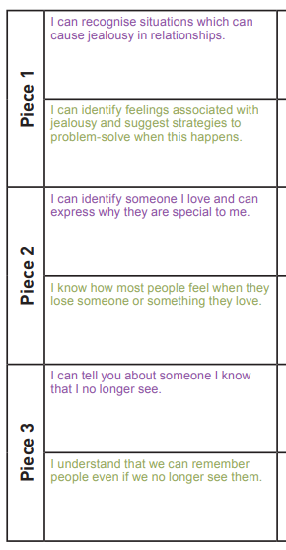
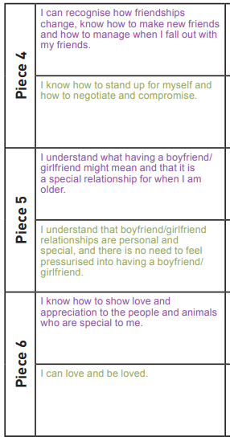
Relationships – Year 4 LOs

Slide 7
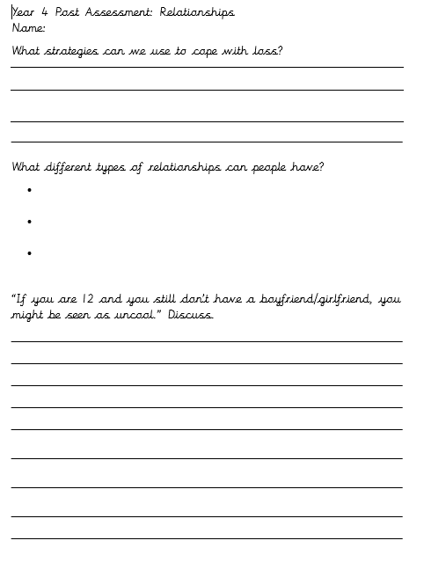
Relationships – Year 4 Post Assessment

