Slide 1
Changing Me
PSHE - Year 4

Slide 2

CM – Year 4 Whole school charter

Slide 3
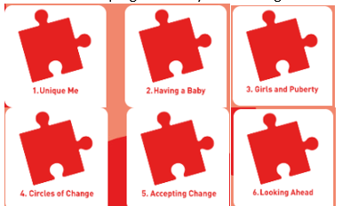
CM – Year 4 Puzzle Pieces

Slide 4
CM – Year 4 Vocabulary
Vocabulary
Personal, Unique, Characteristics, Parents, Sperm, Egg / ovum, Penis, Testicles, Vagina / vulva, Womb / uterus, Ovaries, Making love, Having sex, intercourse, Fertilise, Conception, Puberty, Menstruation, Periods, Circle, Seasons, Change, Control, Emotions, Acceptance, Looking forward, Excited, Nervous, Anxious, Happy
Song: ‘A New Day’
Puzzle Outcome: Tree of Change

Slide 5
CM – Year 4 Links to…
DfE Statutory Relationships & Health Education Guidance.
(R1) that families are important for children growing up because they can give love, security and stability (R2) the characteristics of healthy family life, commitment to each other, including in times of difficulty, protection and care for children and other family members, the importance of spending time together and sharing each other’s lives (R3) that others’ families, either in school or in the wider world, sometimes look different from their family, but that they should respect those differences and know that other children’s families are also characterised by love and care (R4) that stable, caring relationships, which may be of different types, are at the heart of happy families, and are important for children’s security as they grow up (R26) about the concept of privacy and the implications of it for both children and adults; including that it is not always right to keep secrets if they relate to being safe (R27) that each person’s body belongs to them, and the differences between appropriate and inappropriate or unsafe physical, and other, contact.
(H2) that there is a normal range of emotions (e.g. happiness, sadness, anger, fear, surprise, nervousness) and scale of emotions that all humans experience in relation to different experiences and situations(H3) how to recognise and talk about their emotions, including having a varied vocabulary of words to use when talking about their own and others’ feelings H4) how to judge whether what they are feeling and how they are behaving is appropriate and proportionate (H34) key facts about puberty and the changing adolescent body, particularly from age 9 through to age 11, including physical and emotional changes(H35) about menstrual wellbeing including the key facts about the menstrual cycle

Slide 6
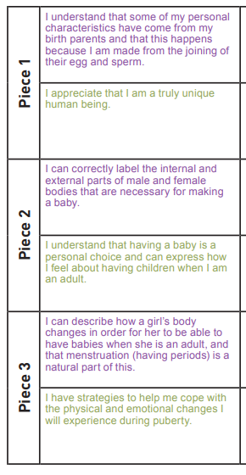
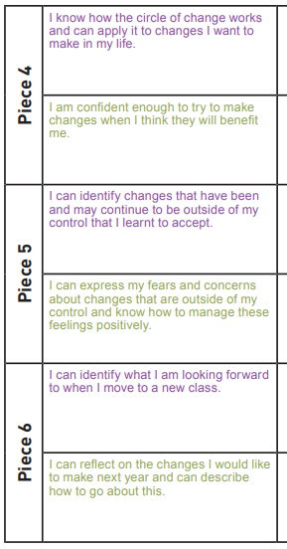
CM – Year 4 LOs

Slide 7
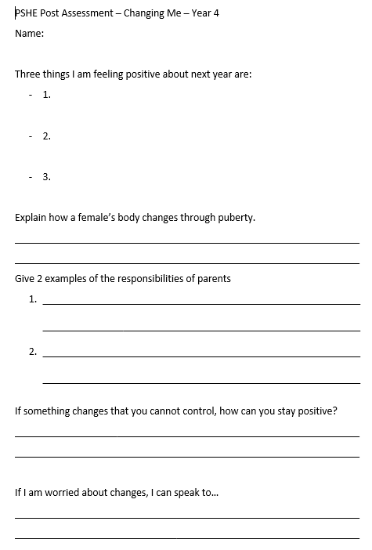
CM – Year 4 Post Assessment

