Slide 1

Being me in My World PSHE - Year 5

Slide 2

BMIMW – Year 5 Whole school charter

Slide 3
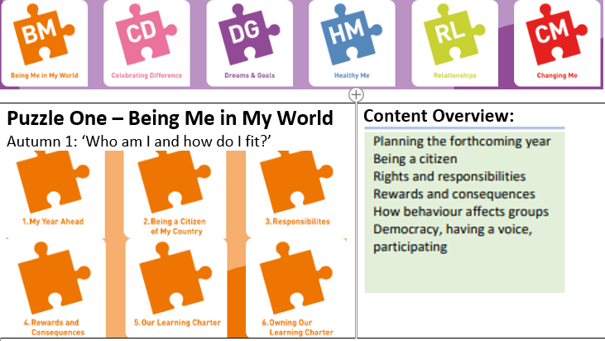
BMIMW – Year 5 Puzzle Pieces

Slide 4
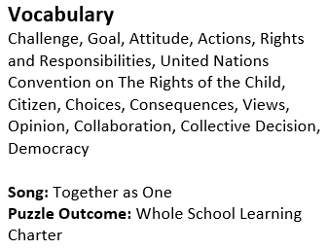
BMIMW – Year 5 Vocabulary

Slide 5
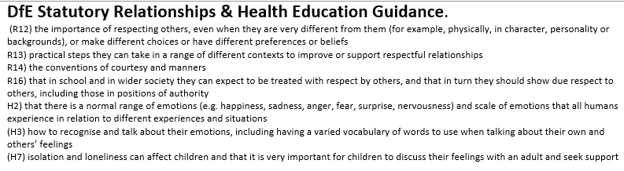
BMIMW – Year 5 Links to…

Slide 6
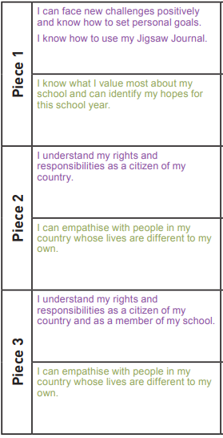
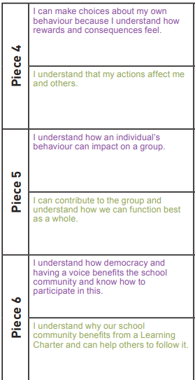
BMIMW – Year 5 LOs

Slide 7
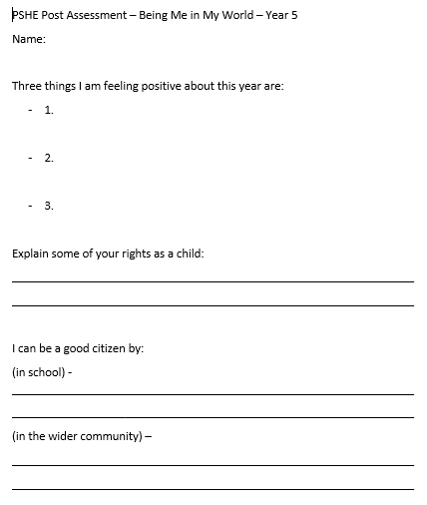
BMIMW – Year 5 Post Assessment

