Slide 1

Celebrating Difference PSHE - Year 5

Slide 2

CD – Year 5 Whole school charter

Slide 3
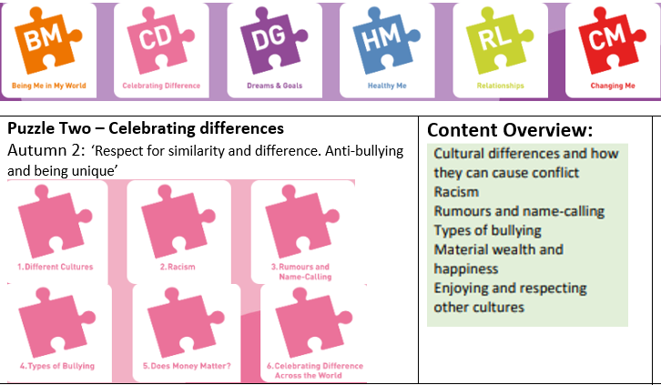
CD – Year 5 Puzzle Pieces

Slide 4
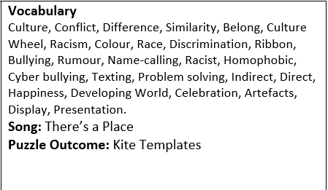
CD – Year 5 Vocabulary

Slide 5
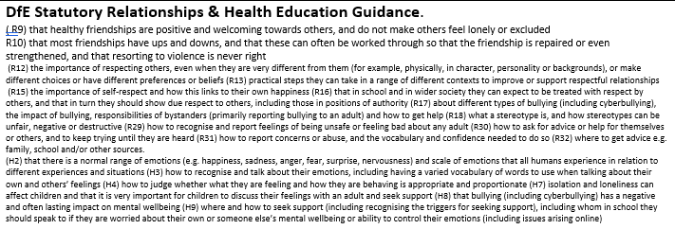
CD – Year 5 Links to…

Slide 6
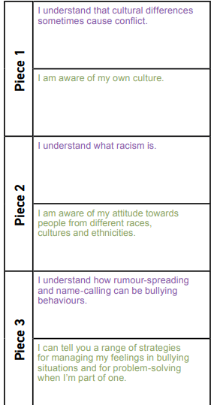
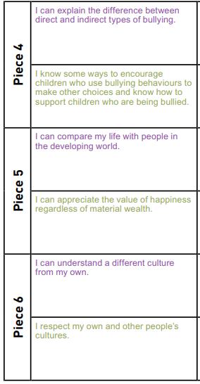
CD – Year 5 LOs

Slide 7
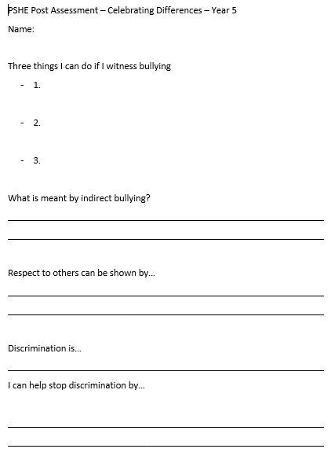
CD – Year 5 Post Assessment

