Slide 1

Dreams and
Goals
PSHE - Year 5

Slide 2

DAG – Year 5 Whole school charter

Slide 3
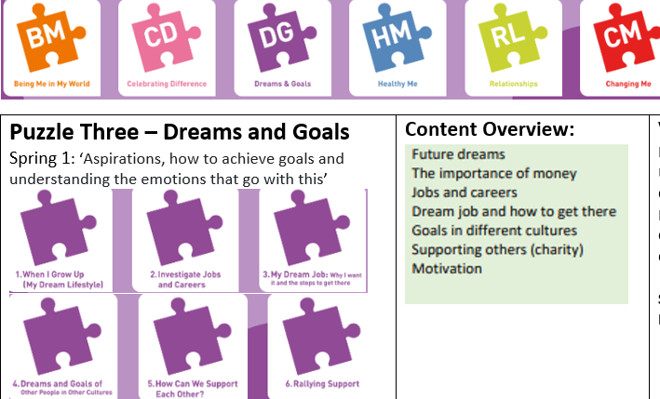
DAG – Year 5 Puzzle Pieces

Slide 4
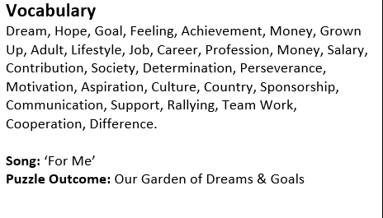
DAG – Year 5 Vocabulary

Slide 5
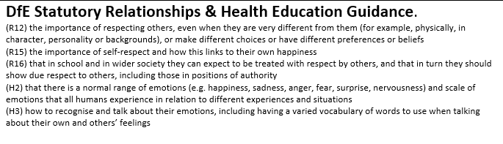
DAG – Year 5 Links to…

Slide 6
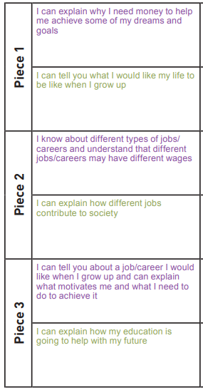
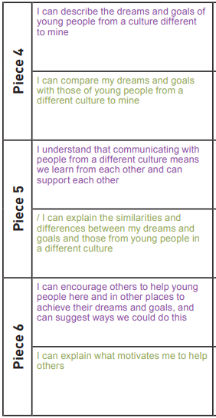
DAG – Year 5 LOs

Slide 7
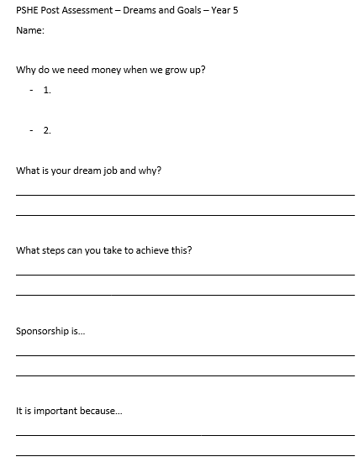
DAG – Year 5 Post Assessment

