Slide 1

Healthy
Me
PSHE - Year 5

Slide 2

HM – Year 5 Whole school charter

Slide 3
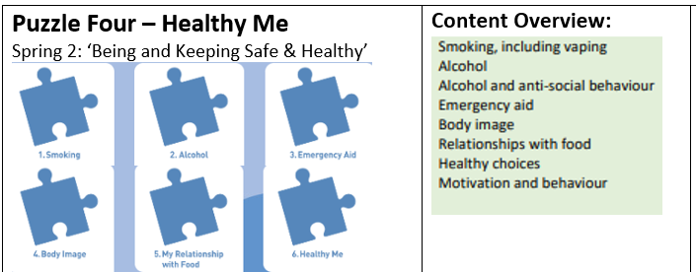
HM – Year 5 Puzzle Pieces

Slide 4
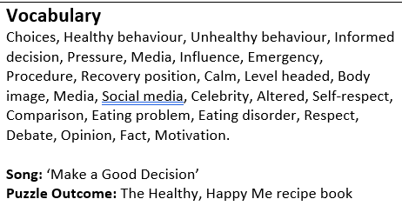
HM – Year 5 Vocabulary

Slide 5
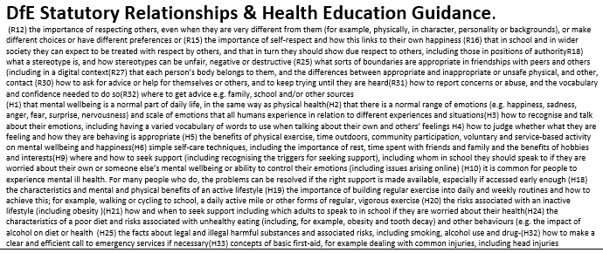
HM – Year 5 Links to…

Slide 6
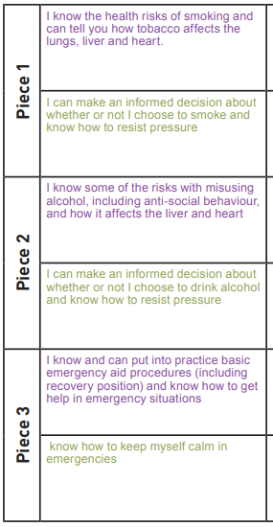
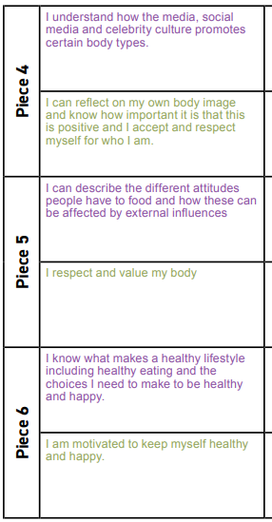
HM – Year 5 LOs

Slide 7
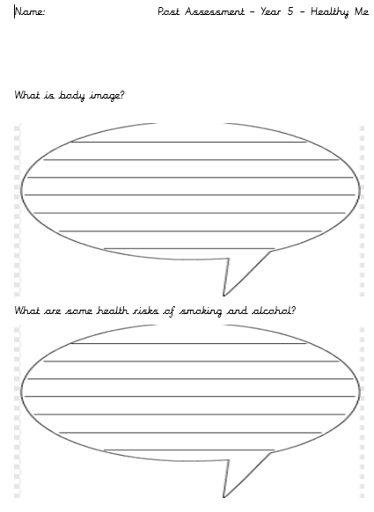
HM – Year 5 Post Assessment

