Slide 1

Relationships
PSHE - Year 5

Slide 2

Relationships – Year 5 Whole school charter

Slide 3
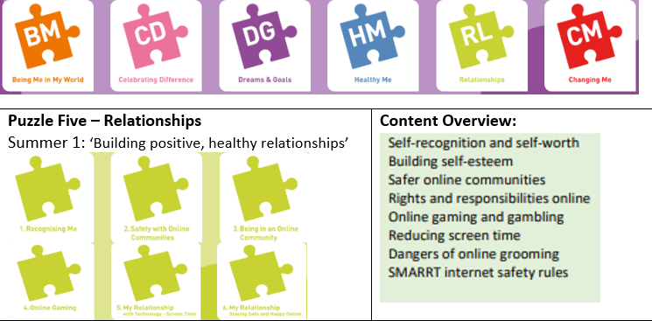
Relationships – Year 5 Puzzle Pieces

Slide 4
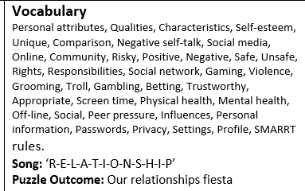
Relationships – Year 5 Vocabulary

Slide 5
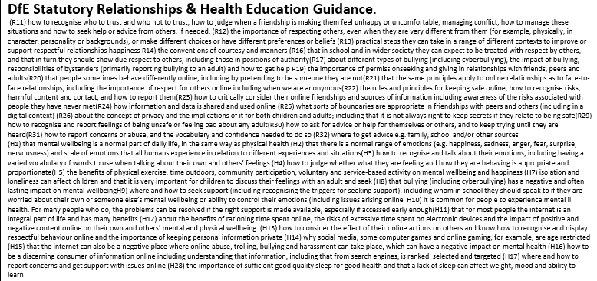
Relationships – Year 5 Links to…

Slide 6
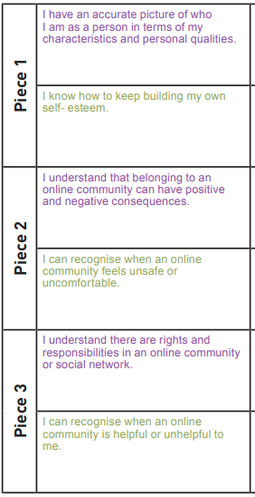
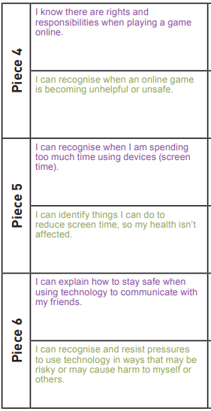
Relationships – Year 5 LOs

Slide 7
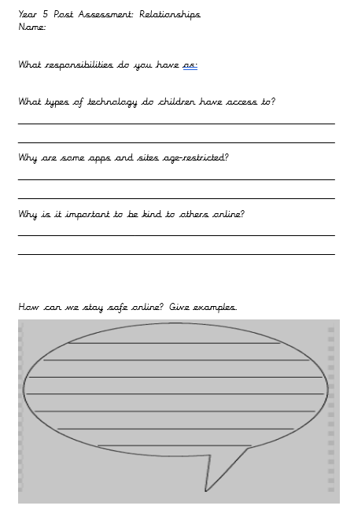
Relationships – Year 5 Post Assessment

