Slide 1

Changing Me
PSHE - Year 5

Slide 2

CM – Year 5 Whole school charter

Slide 3
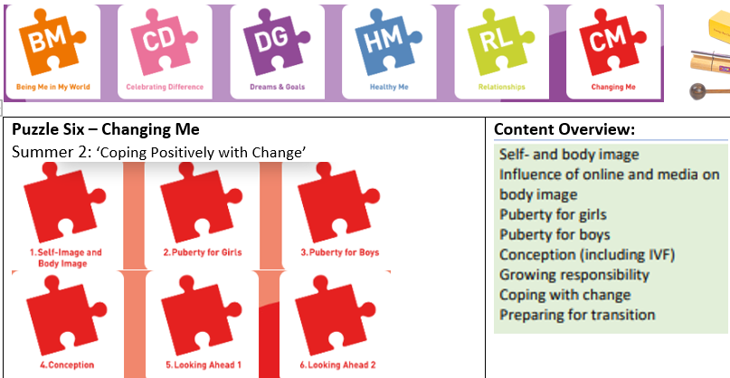
CM – Year 5 Puzzle Pieces

Slide 4
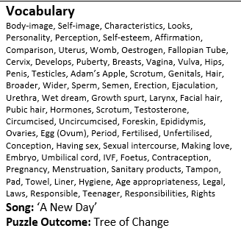
CM – Year 5 Vocabulary

Slide 5
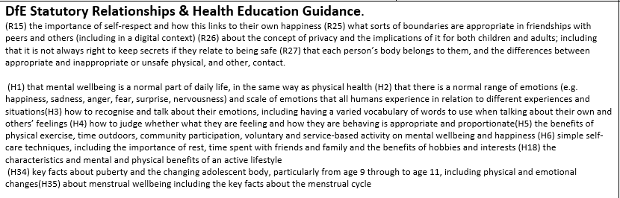
CM – Year 5 Links to…

Slide 6
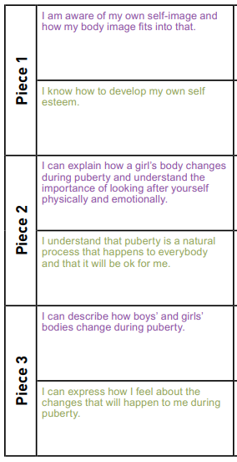
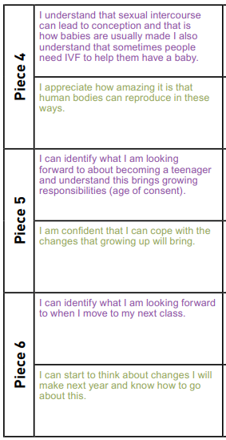
CM – Year 5 LOs

Slide 7
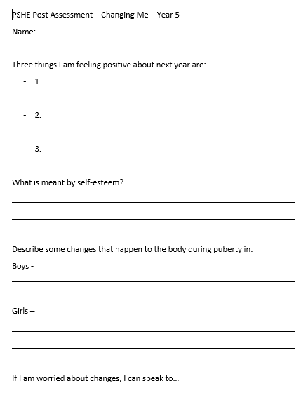
CM – Year 5 Post Assessment

