Slide 1
Being me in My World PSHE - Year 6

Slide 2

BMIMW – Year 6 Whole school charter

Slide 3
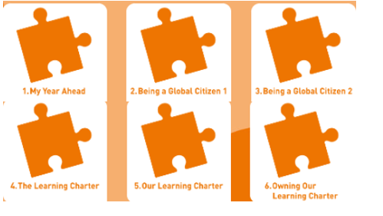
BMIMW – Year 6 Puzzle Pieces

Slide 4
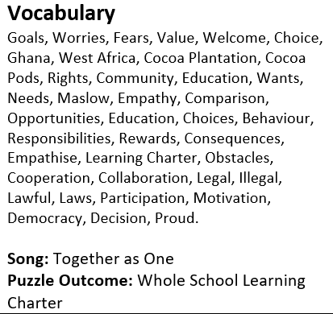
BMIMW – Year 6 Vocabulary

Slide 5
BMIMW – Year 6 Links to…
DfE Statutory Relationships & Health Education Guidance.
(R6) how to recognise if family relationships are making them feel unhappy or unsafe, and how to seek help or advice from others if needed
(R7) how important friendships are in making us feel happy and secure, and how people choose and make friends
(R12) the importance of respecting others, even when they are very different from them (for example, physically, in character, personality or backgrounds), or make different choices or have different preferences or beliefs
R13) practical steps they can take in a range of different contexts to improve or support respectful relationships
R14) the conventions of courtesy and manners
R25) what sorts of boundaries are appropriate in friendships with peers and others (including in a digital context)
H2) that there is a normal range of emotions (e.g. happiness, sadness, anger, fear, surprise, nervousness) and scale of emotions that all humans experience in relation to different experiences and situations
(H3) how to recognise and talk about their emotions, including having a varied vocabulary of words to use when talking about their own and others’ feelings
(H4) how to judge whether what they are feeling and how they are behaving is appropriate and proportionate

Slide 6
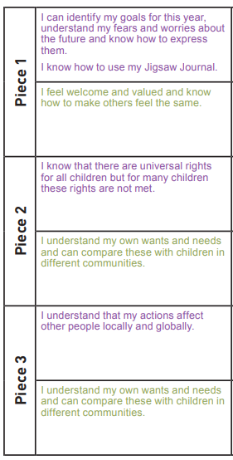
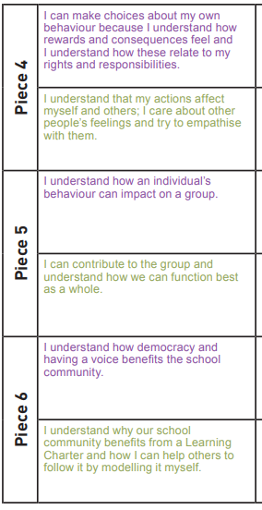
BMIMW – Year 6 LOs

Slide 7
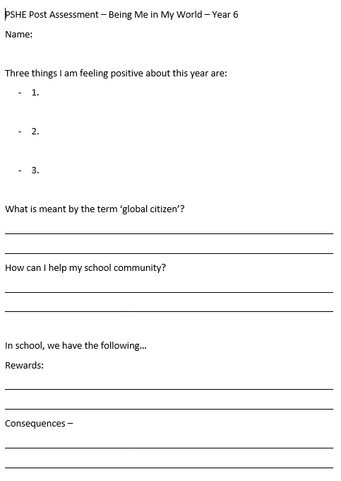
BMIMW – Year 6 Post Assessment

