Slide 1
Celebrating Difference PSHE - Year 6

Slide 2

CD – Year 6 Whole school charter

Slide 3
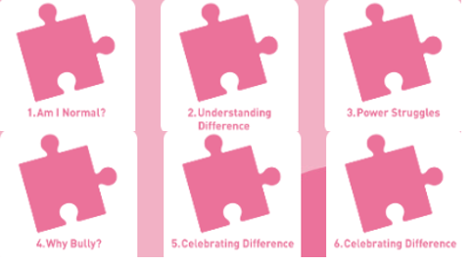
CD – Year 6 Puzzle Pieces

Slide 4
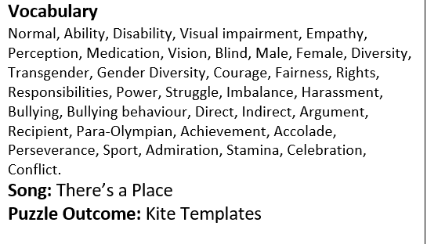
CD – Year 6 Vocabulary

Slide 5
CD – Year 6 Links to…
DfE Statutory Relationships & Health Education Guidance.
(R3) that others’ families, either in school or in the wider world, sometimes look different from their family, but that they should respect those differences and know that other children’s families are also characterised by love and care
(R11) how to recognise who to trust and who not to trust, how to judge when a friendship is making them feel unhappy or uncomfortable, managing conflict, how to manage these situations and how to seek help or advice from others, if needed (R12) the importance of respecting others, even when they are very different from them (for example, physically, in character, personality or backgrounds), or make different choices or have different preferences or beliefs (R13) practical steps they can take in a range of different contexts to improve or support respectful relationships
(R15) the importance of self-respect and how this links to their own happiness (R16) that in school and in wider society they can expect to be treated with respect by others, and that in turn they should show due respect to others, including those in positions of authority
(R17) about different types of bullying (including cyberbullying), the impact of bullying, responsibilities of bystanders (primarily reporting bullying to an adult) and how to get help (R18) what a stereotype is, and how stereotypes can be unfair, negative or destructive(R19) the importance of permissionseeking and giving in relationships with friends, peers (R21) that the same principles apply to online relationships as to face-to-face relationships, including the importance of respect for others online including when we are anonymous (R25) what sorts of boundaries are appropriate in friendships with peers and others (including in a digital context) (R30) how to ask for advice or help for themselves or others, and to keep trying until they are heard(R30) how to ask for advice or help for themselves or others, and to keep trying until they are heard (R31) how to report concerns or abuse, and the vocabulary and confidence needed to do so (R32) where to get advice e.g. family, school and/or other sources.
(H2) that there is a normal range of emotions (e.g. happiness, sadness, anger, fear, surprise, nervousness) and scale of emotions that all humans experience in relation to different experiences and situations (H3) how to recognise and talk about their emotions, including having a varied vocabulary of words to use when talking about their own and others’ feelings (H4) how to judge whether what they are feeling and how they are behaving is appropriate and proportionate (H7) isolation and loneliness can affect children and that it is very important for children to discuss their feelings with an adult and seek support (H8) that bullying (including cyberbullying) has a negative and often lasting impact on mental wellbeing (H10) it is common for people to experience mental ill health. For many people who do, the problems can be resolved if the right support is made available, especially if accessed early enough) (H13) how to consider the effect of their online actions on others and know how to recognise and display respectful behaviour online and the importance of keeping personal information private(H17) where and how to report concerns and get support with issues online

Slide 6
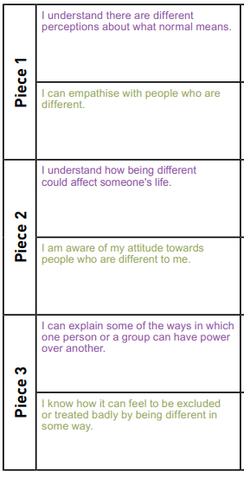
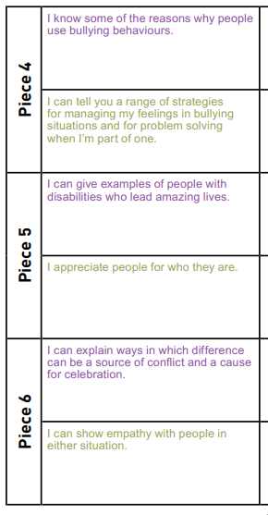
CD – Year 6 LOs

Slide 7
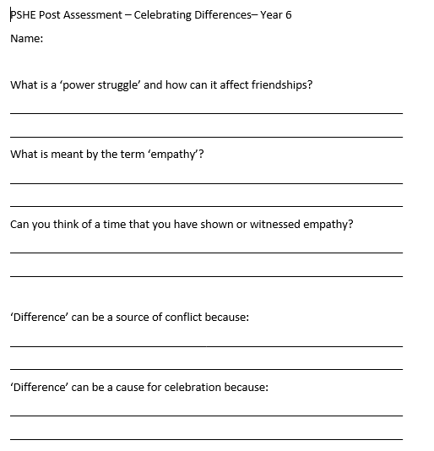
CD – Year 6 Post Assessment

