Slide 1
Dreams and
Goals
PSHE - Year 6

Slide 2

DAG – Year 6 Whole school charter

Slide 3
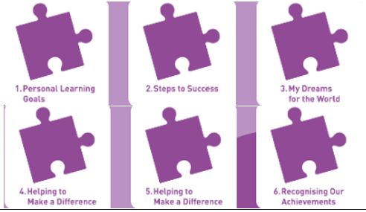
DAG – Year 6 Puzzle Pieces

Slide 4
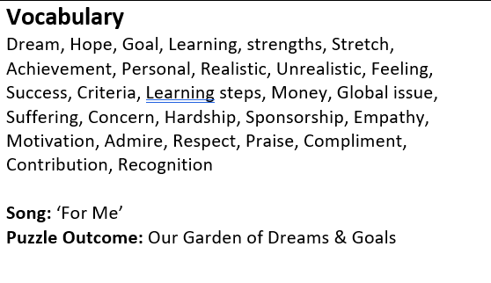
DAG – Year 6 Vocabulary

Slide 5
DAG – Year 6 Links to…
DfE Statutory Relationships & Health Education Guidance.
(R12) the importance of respecting others, even when they are very different from them (for example, physically, in character, personality or backgrounds), or make different choices or have different preferences or beliefs
(R13) practical steps they can take in a range of different contexts to improve or support respectful relationships
(R15) the importance of self-respect and how this links to their own happiness
(R16) that in school and in wider society they can expect to be treated with respect by others, and that in turn they should show due respect to others, including those in positions of authority
(H2) that there is a normal range of emotions (e.g. happiness, sadness, anger, fear, surprise, nervousness) and scale of emotions that all humans experience in relation to different experiences and situations
(H3) how to recognise and talk about their emotions, including having a varied vocabulary of words to use when talking about their own and others’ feelings
(H4) how to judge whether what they are feeling and how they are behaving is appropriate and proportionate (H7) isolation and loneliness can affect children and that it is very important for children to discuss their feelings with an adult and seek support

Slide 6
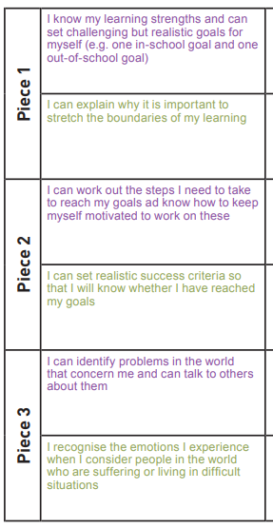
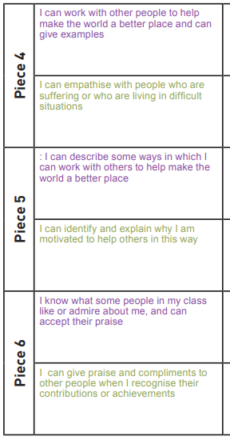
DAG – Year 6 LOs

Slide 7
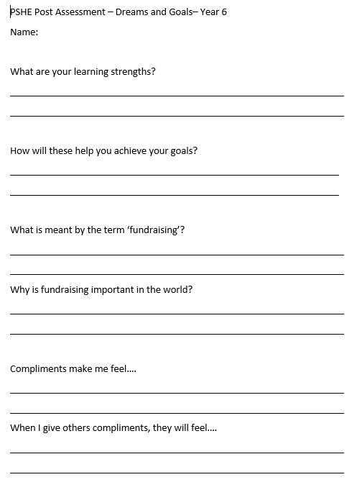
DAG – Year 6 Post Assessment

