Slide 1
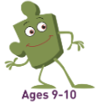
Healthy
Me
PSHE - Year 6

Slide 2

HM – Year 6 Whole school charter

Slide 3
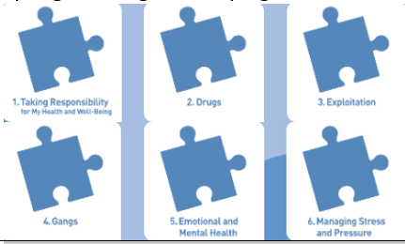
HM – Year 6 Puzzle Pieces

Slide 4
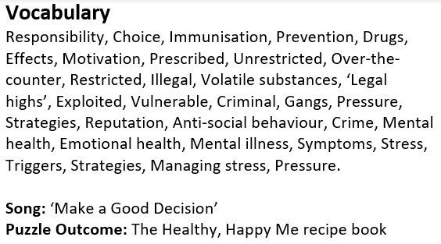
HM – Year 6 Vocabulary

Slide 5
HM – Year 6 Links to…
DfE Statutory Relationships & Health Education Guidance.
(R6) how to recognise if family relationships are making them feel unhappy or unsafe, and how to seek help or advice from others if needed (R7) how important friendships are in making us feel happy and secure, and how people choose and make friends (R11) how to recognise who to trust and who not to trust, how to judge when a friendship is making them feel unhappy or uncomfortable, managing conflict, how to manage these situations and how to seek help or advice from others, if needed. needed (R12) the importance of respecting others, even when they are very different from them (for example, physically, in character, personality or backgrounds), or make different choices or have different preferences or beliefs (R15) the importance of self-respect and how this links to their own happiness (R16) that in school and in wider society they can expect to be treated with respect by others, and that in turn they should show due respect to others, including those in positions of authority(R19) the importance of permissionseeking and giving in relationships with friends, peers and adults(R25) what sorts of boundaries are appropriate in friendships with peers and others (including in a digital context)(R26) about the concept of privacy and the implications of it for both children and adults; including that it is not always right to keep secrets if they relate to being safe(R30) how to ask for advice or help for themselves or others, and to keep trying until they are heard(R31) how to report concerns or abuse, and the vocabulary and confidence needed to do so(R32) where to get advice e.g. family, school and/or other sources(H1) that mental wellbeing is a normal part of daily life, in the same way as physical health(H2) that there is a normal range of emotions (e.g. happiness, sadness, anger, fear, surprise, nervousness) and scale of emotions that all humans experience in relation to different experiences and situations(H3) how to recognise and talk about their emotions, including having a varied vocabulary of words to use when talking about their own and others’ feelings H4) how to judge whether what they are feeling and how they are behaving is appropriate (H5) the benefits of physical exercise, time outdoors, community participation, voluntary and service-based activity on mental wellbeing and happiness(H6) simple self-care techniques, including the importance of rest, time spent with friends and family and the benefits of hobbies and interests(H7) isolation and loneliness can affect children and that it is very important for children to discuss their feelings with an adult and seek support(H8) that bullying (including cyberbullying) has a negative and often lasting impact on mental wellbeing(H9) where and how to seek support (including recognising the triggers for seeking support), including whom in school they should speak to if they are worried about their own or someone else’s mental wellbeing or ability to control their emotions (including issues arising online) (H10) it is common for people to experience mental ill health. For many people who do, the problems can be resolved if the right support is made available, especially if accessed early (H12) about the benefits of rationing time spent online, the risks of excessive time spent on electronic devices and the impact of positive and negative content online on their own and others’ mental and physical wellbeing. (H17) where and how to report concerns and get support with issues online(H18) the characteristics and mental and physical benefits of an active lifestyle(H19) the importance of building regular exercise into daily and weekly routines and how to achieve this; for example, walking or cycling to school, a daily active mile or other forms of regular, vigorous exercise(H20) the risks associated with an inactive lifestyle (including obesity (H21) how and when to seek support including which adults to speak to in school if they are worried about their health(H24) the characteristics of a poor diet and risks associated with unhealthy eating (including, for example, obesity and tooth decay) and other behaviours (e.g. the impact of alcohol on diet)

Slide 6
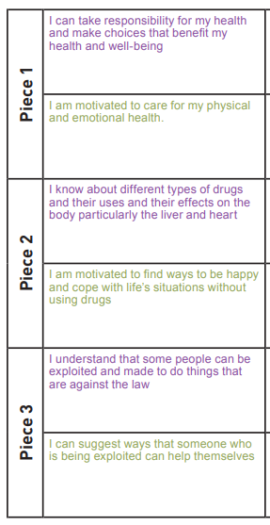
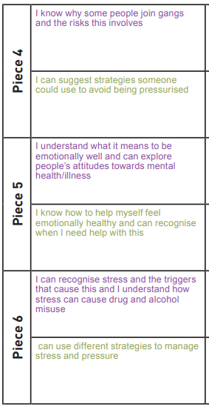
HM – Year 6 LOs

Slide 7
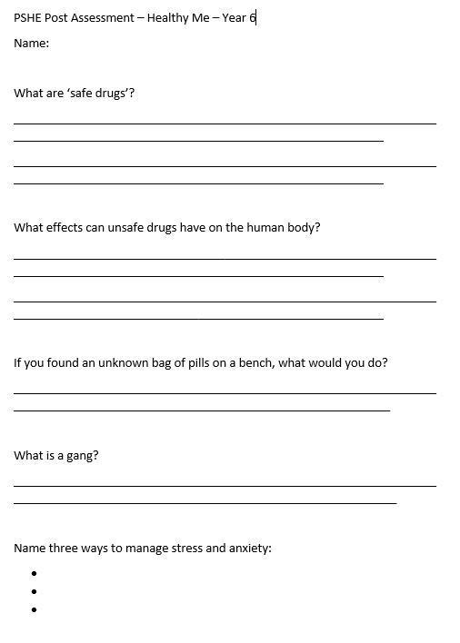
HM – Year 6 Post Assessment

