Slide 1
Relationships
PSHE - Year 6

Slide 2

Relationships – Year 6 Whole school charter

Slide 3
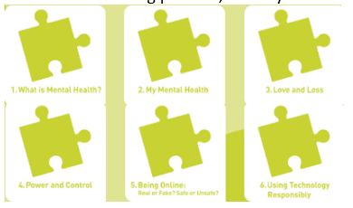
Relationships – Year 6 Puzzle Pieces

Slide 4
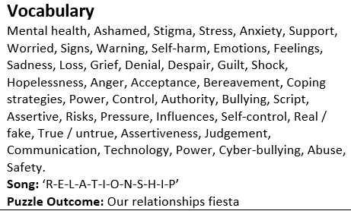
Relationships – Year 6 Vocabulary

Slide 5
Relationships – Year 6 Links to…
(R8) the characteristics of friendships, including mutual respect, truthfulness, trustworthiness, loyalty, kindness, generosity, trust, sharing interests and experiences and support with problems and difficulties(R9) that healthy friendships are positive and welcoming towards others, and do not make others feel lonely or excluded (R10) that most friendships have ups and downs, and that these can often be worked through so that the friendship is repaired or even strengthened, and that resorting to violence is never right (R11) how to recognise who to trust and who not to trust, how to judge when a friendship is making them feel unhappy or uncomfortable, managing conflict, how to manage these situations and how to seek help or advice from others, if needed. (R13) practical steps they can take in a range of different contexts to improve or support respectful relationships happiness (R15) the importance of self-respect and how this links to their own happiness(R17) about different types of bullying (including cyberbullying), the impact of bullying, responsibilities of bystanders (primarily reporting bullying to an adult) and how to get help R19) the importance of permissionseeking and giving in relationships with friends, peers and adults (R20) that people sometimes behave differently online, including by pretending to be someone they are not (R21) that the same principles apply to online relationships as to face-to-face relationships, including the importance of respect for others online including when we are anonymous (R22) the rules and principles for keeping safe online, how to recognise risks, harmful content and contact, and how to report them (R23) how to critically consider their online friendships and sources of information including awareness of the risks associated with people they have never met (R24) how information and data is shared and used online (R25) what sorts of boundaries are appropriate in friendships with peers and others (including in a digital context) R24) how information and data is shared and used online (R27) that each person’s body belongs to them, and the differences between appropriate and inappropriate or unsafe physical, and other, contact (R28) how to respond safely and appropriately to adults they may encounter (in all contexts, including online) whom they do not know (R29) how to recognise and report feelings of being unsafe or feeling bad about any adult (R30) how to ask for advice or help for themselves or others, and to keep trying until they are heard (R31) how to report concerns or abuse, and the vocabulary and confidence needed to do so (R32) where to get advice e.g. family, school and/or other sources (H1) that mental wellbeing is a normal part of daily life, in the same way as physical health (H2) that there is a normal range of emotions (e.g. happiness, sadness, anger, fear, surprise, nervousness) and scale of emotions that all humans experience in relation to different experiences and situations(H3) how to recognise and talk about their emotions, including having a varied vocabulary of words to use when talking about their own and others’ feelings (H4) how to judge whether what they are feeling and how they are behaving is appropriate and proportionate(H5) the benefits of physical exercise, time outdoors, community participation, voluntary and service-based activity on mental wellbeing and happiness(H6) simple self-care techniques, including the importance of rest, time spent with friends and family and the benefits of hobbies and interests (H7) isolation and loneliness can affect children and that it is very important for children to discuss their feelings with an adult and seek (H8) that bullying (including cyberbullying) has a negative and often lasting impact on mental wellbeing (H9) where and how to seek support (including recognising the triggers for seeking support), including whom in school they should speak to if they are worried about their own or someone else’s mental wellbeing or ability to control their emotions (including issues arising online (H10) it is common for people to experience mental ill health. For many people who do, the problems can be resolved if the right support is made available, especially if accessed early enough(H11) that for most people the internet is an integral part of life and has many benefits(H12) about the benefits of rationing time spent online, the risks of excessive time spent on electronic devices and the impact of positive and negative content online on their own and others’ mental and physical wellbeing(H13) how to consider the effect of their online actions on others and know how to recognise and display respectful behaviour online and the importance of keeping personal information private(H14) why social media, some computer games and online gaming, for example, are age restricted(H15) that the internet can also be a negative place where online abuse, trolling, bullying and harassment can take place, which can have a negative impact on mental health(H16) how to be a discerning consumer of information online including understanding that information, including that from search engines, is ranked, selected and targeted(H17) where and how to report concerns and get support with issues online(H18) the characteristics and mental and physical benefits of an active lifestyle(H21) how and when to seek support including which adults to speak to in school if they are worried about their health

Slide 6
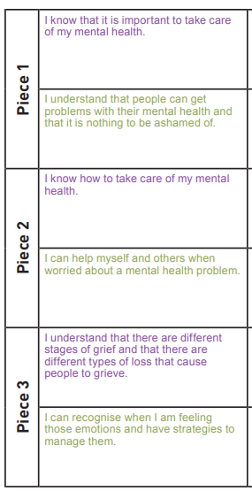
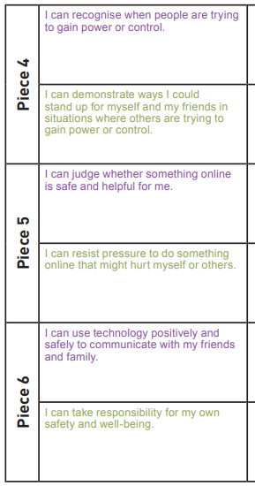
Relationships – Year 6 LOs

Slide 7
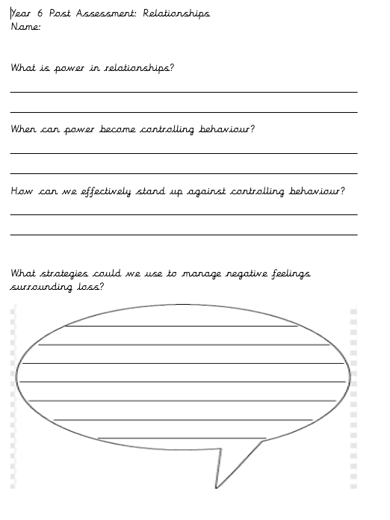
Relationships – Year 6 Post Assessment

