Slide 1
Changing Me
PSHE - Year 6

Slide 2

CM – Year 6 Whole school charter

Slide 3
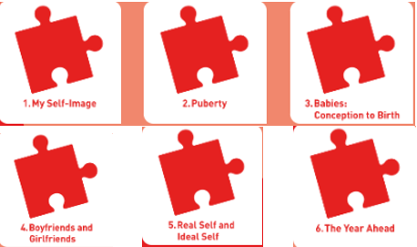
CM – Year 6 Puzzle Pieces

Slide 4
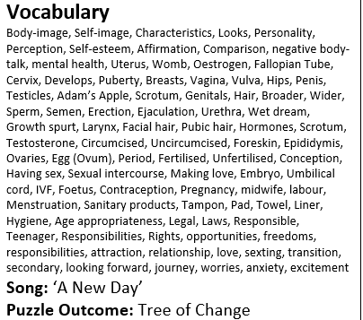
CM – Year 6 Vocabulary

Slide 5
CM – Year 6 Links to…
DfE Statutory Relationships & Health Education Guidance.
(R1) that families are important for children growing up because they can give love, security and stability (R4) that stable, caring relationships, which may be of different types, are at the heart of happy families, and are important for children’s security as they grow up (R6) how to recognise if family relationships are making them feel unhappy or unsafe, and how to seek help or advice from others if needed(R7) how important friendships are in making us feel happy and secure, and how people choose and make friends(R8) the characteristics of friendships, including mutual respect, truthfulness, trustworthiness, loyalty, kindness, generosity, trust, sharing interests and experiences and support with problems and difficulties(R9) that healthy friendships are positive and welcoming towards others, and do not make others feel lonely or excluded(R13) practical steps they can take in a range of different contexts to improve or support respectful relationships(R15) the importance of self-respect and how this links to their own happiness(R16) that in school and in wider society they can expect to be treated with respect by others, and that in turn they should show due respect to others, including those in positions of authority(R19) the importance of permissionseeking and giving in relationships with friends, peers and adults (R27) that each person’s body belongs to them, and the differences between appropriate and inappropriate or unsafe physical, and other, contact. (R30) how to ask for advice or help for themselves or others, and to keep trying until they are heard(R32) where to get advice e.g. family, school and/or other sources
sources (H1) that mental wellbeing is a normal part of daily life, in the same way as physical health (H2) that there is a normal range of emotions (e.g. happiness, sadness, anger, fear, surprise, nervousness) and scale of emotions that all humans experience in relation to different experiences and situations(H3) how to recognise and talk about their emotions, including having a varied vocabulary of words to use when talking about their own and others’ feelings (H4) how to judge whether what they are feeling and how they are behaving is appropriate and proportionate (H6) simple self-care techniques, including the importance of rest, time spent with friends and family and the benefits of hobbies and interests (H7) isolation and loneliness can affect children and that it is very important for children to discuss their feelings with an adult and seek. wellbeing (H9) where and how to seek support (including recognising the triggers for seeking support), including whom in school they should speak to if they are worried about their own or someone else’s mental wellbeing or ability to control their emotions (including issues arising online (H10) it is common for people to experience mental ill health. For many people who do, the problems can be resolved if the right support is made available, especially if accessed early enough(H34) key facts about puberty and the changing adolescent body, particularly from age 9 through to age 11, including physical and emotional changesH35) about menstrual wellbeing including the key facts about the menstrual cycle

Slide 6
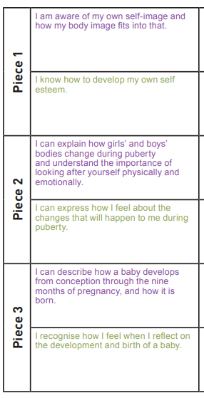
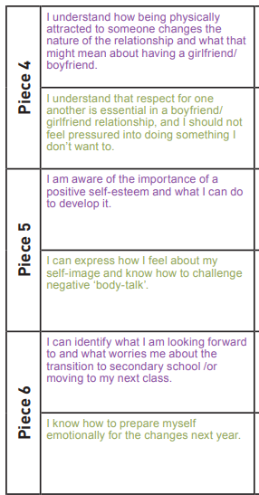
CM – Year 6 LOs

Slide 7
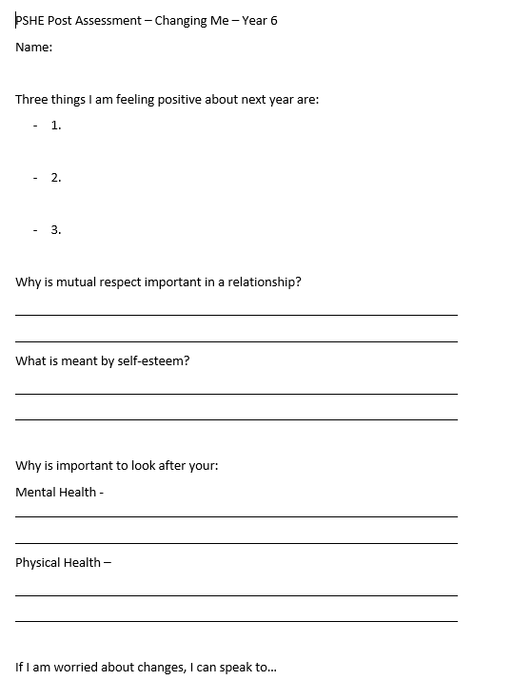
CM – Year 6 Post Assessment

