Slide 1
Planning Maths at TJS
How it all links together!

Slide 2
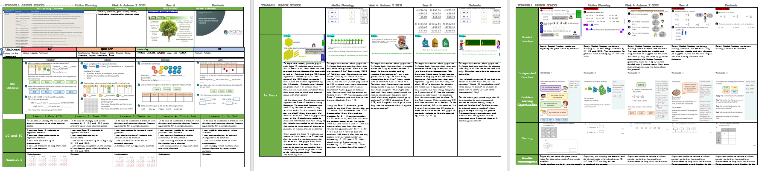
Maths No Problem
The planning format ensures all team members understand the progression of learning objectives over a week. All lesson objectives are taken from Maths No Problem and are taught in the order prescribed in the books/order best to meet the needs of the children Learning Objectives and Success Criteria will be shared in every lesson.
The plan includes all aspects of Maths for a week at a time: what will be taught in each lesson; The outcomes of Pre Assessment; the <20% for each class; same day support activity ideas; Fluent in 5 questions for the start of each lesson; the Ready to Progress focus for the 1x weekly Written Arithmetic session; The BIG Maths (open ended problem solving 1x week) and the daily Problem Solving provision.

Slide 3

Unit Overview and Learning Objectives
This gives an overview of the Maths No Problem Chapter being taught. It can be a screenshot from the LO overview, which can be accessed from the school website, this gives everyone an understanding of the progression of learning through each unit.
This is where the LO can be found for every lesson and copied onto the weekly plan.
Learning objectives will clearly show the key learning being taught in that lesson.

Slide 4
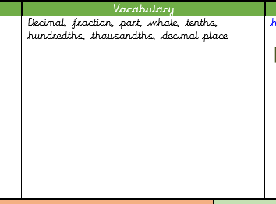

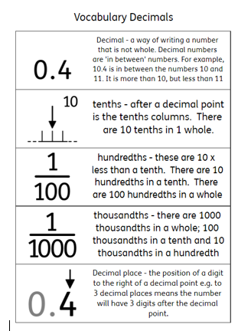
Vocabulary and Widgit Cards
Vocabulary is added to the plan. Key vocabulary can be found by looking at the Maths No problem Text Book for the series of lessons, particularly from the Let’s Learn sections.
The key vocabulary should then be added to a Widget Card: this can be given as a pre-teach to EAL or pupils who need additional support (on Green card) to stick in their books; be added to flipcharts to highlight key vocabulary needed for the lesson and displayed on Working Walls.
Pupils will have a vocabulary card for each new unit, wherever appropriate. These will be displayed in classrooms so pupils are able to use the terms accurately when giving verbal and written responses.

Slide 5

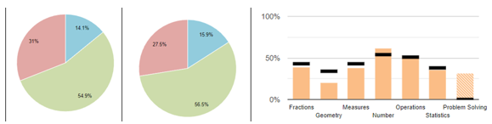
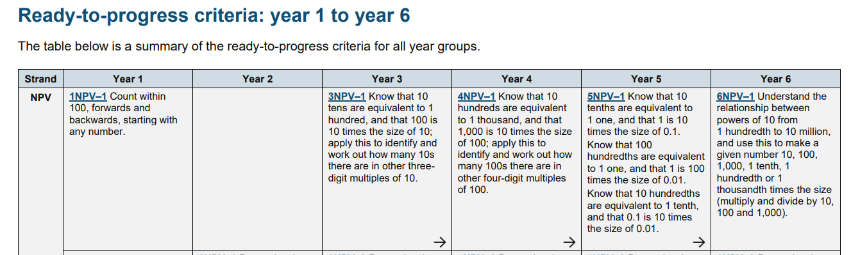
Written Arithmetic
Written Arithmetic should be used to ensure pupils are Ready to Progress in different units of Maths. The Ready to Progress Exemplification Materials should form the basis of the 30min weekly session.
The focus of each session can be identified in a combination of ways:
1. Use of PUMA data for the year group. The graph clearly shows areas where learning is not at/above National average.
In this data, Geometry is below average. An objective from this area of Maths could be selected as a focus for Written Arithmetic.
2. A Pre Assessment may have shown a gap in a particular aspect of the next unit to be taught.
3. We look at the Ready To Progress Criteria in advance of a new unit to identify what pupils need to have achieved in previous year groups to enable them to access the new learning. If a gap is identified, that objective will be covered in Written Arithmetic using the exemplification materials linked at the top of this page.

Slide 6


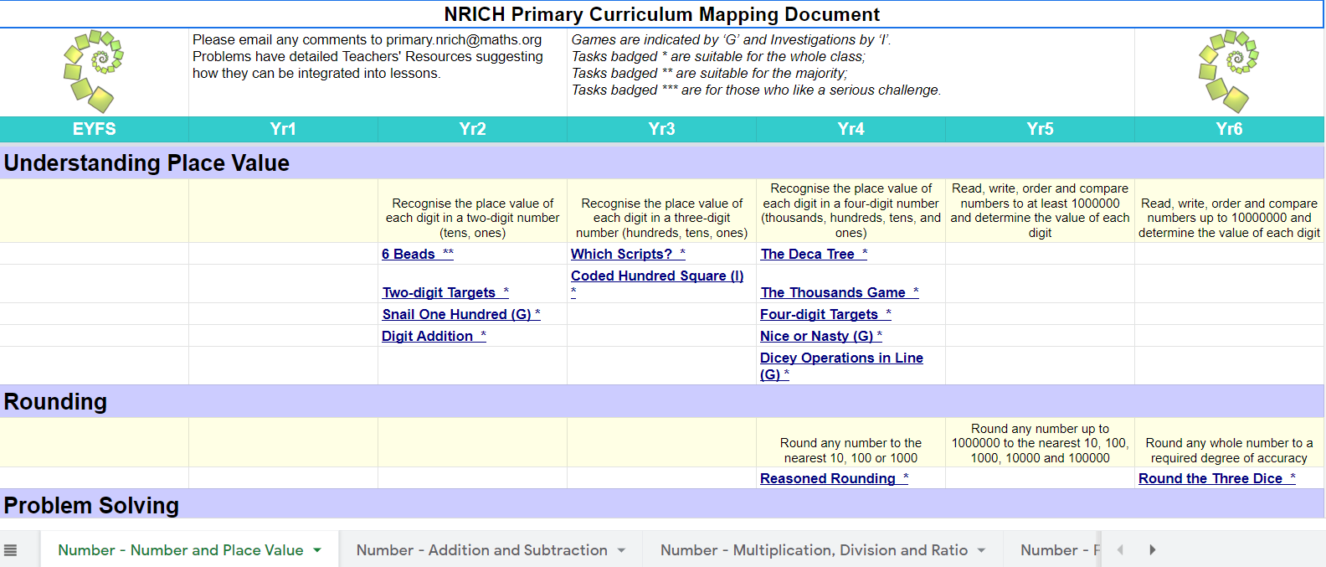


BIG Maths
This is a half hour problem solving activity (1x 30min a week). It should give children a chance to apply problem solving skills and reasoning.
Once a Ready to Progress session has been selected (see previous slide), it will often include a link to a suitable NRICH problem solving activity that will consolidate the learning from the Written Arithmetic.
If your Ready to Progress does not have a link, most BIG Maths can be chosen from the Nrich Primary Curriculum Mapping Document
Problems are sorted by topic and year group
Tabs at the bottom sort problems further
For children working at Pre Key stage (that cannot access the Maths needed in BIG Maths) a Low threshold High Ceiling problem can be selected from NRICH

Slide 7
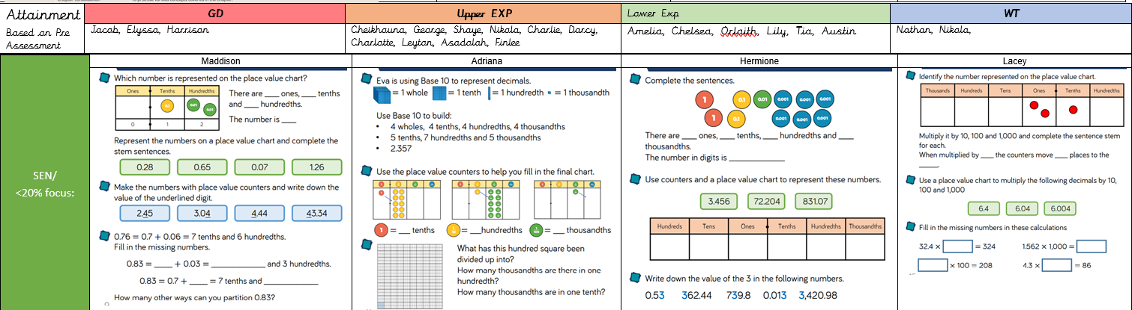
Attainment and Same Day Support
After completing a pre assessment, children in each class should be entered at the top of the plan. This will alter based on Assessment for Learning. The <20% should be named below.
The 4 boxes should contain an example activity for same day support. This should closely match the learning of the lesson.
It should give additional fluency practise of the main learning/methods taught in the lesson. White Rose SOL have suitable fluency activities for most lesson objectives.
Same day support should happen daily: the purpose is to ensure pupils are ready to progress to the next lesson..

Slide 8
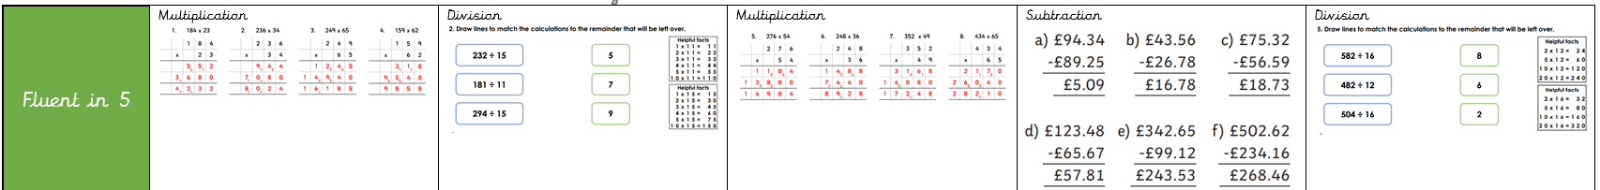
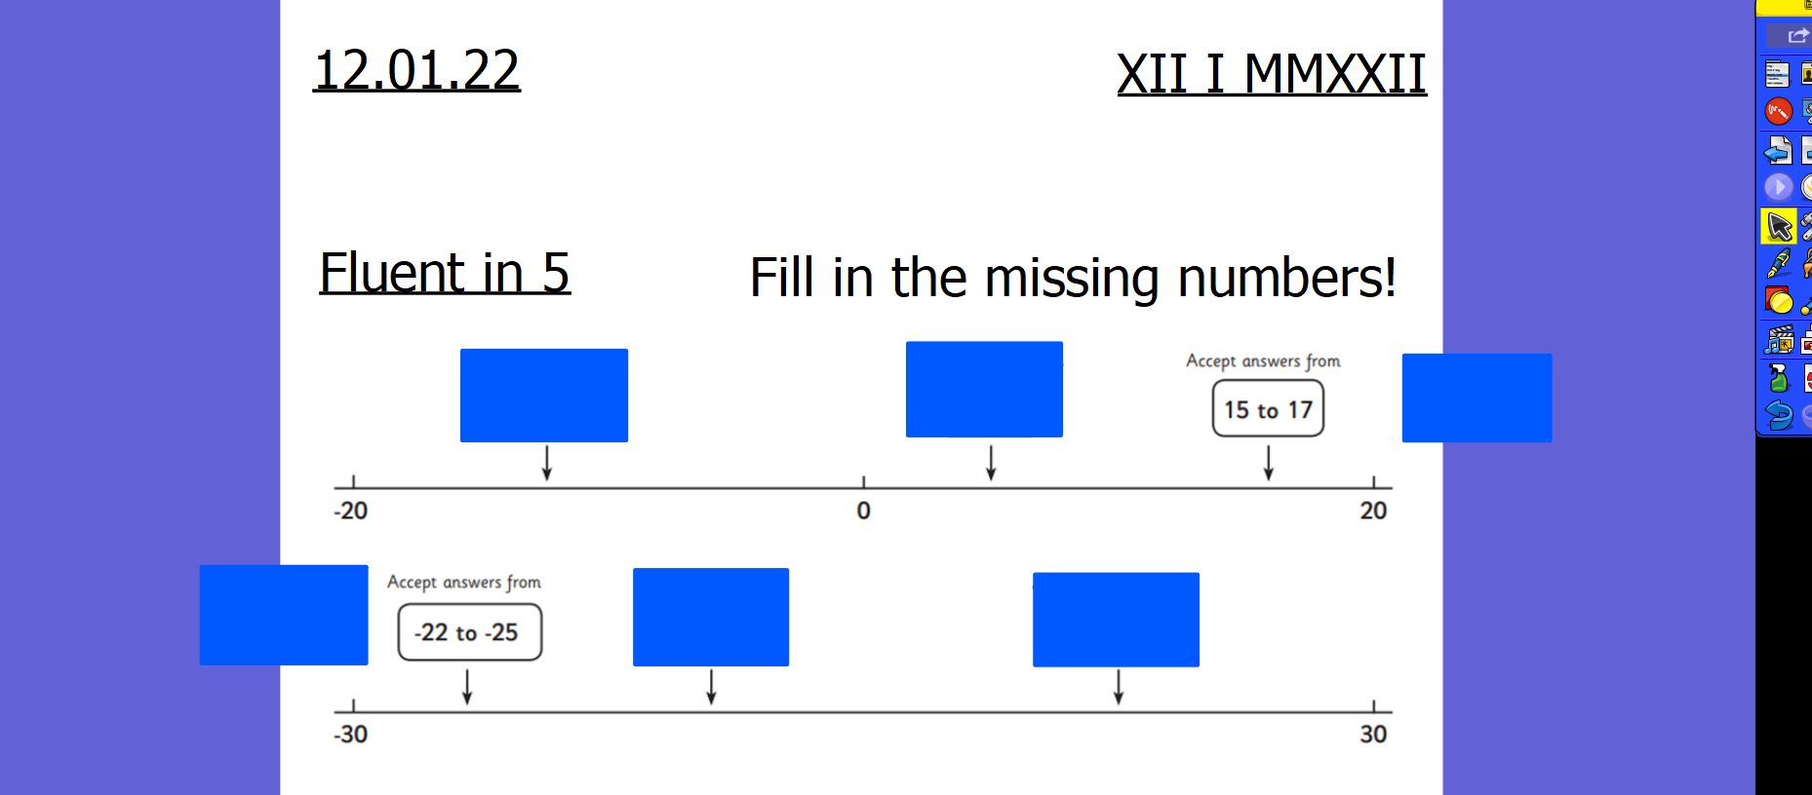
Fluent in 5
Fluent in 5 aims to improve fluency (speed and accuracy) and should be included in every lesson lasting 5 minutes. The questions should all be on the same aspect of Maths, but the concept practiced may change day to day.
Fluent in 5 is a chance to keep previously taught Maths ‘on the boil’; can refresh a method they will need in an upcoming lesson and consolidate new learning.
Questions can be created by the teacher, or taken from a variety of teaching resources websites.
Fluent in 5 will be in books and will be marked.

Slide 9
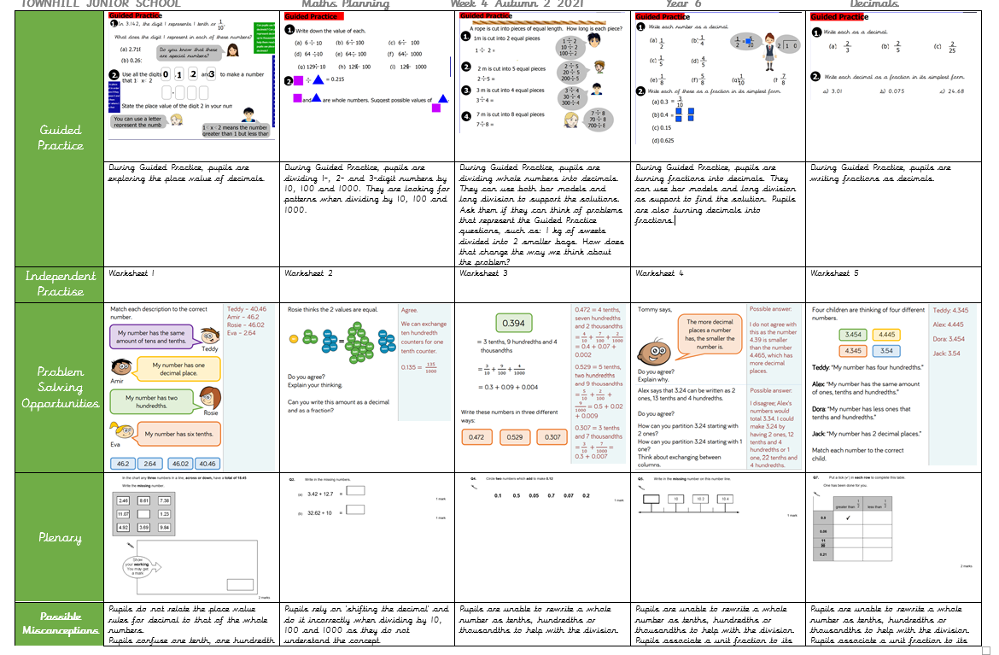
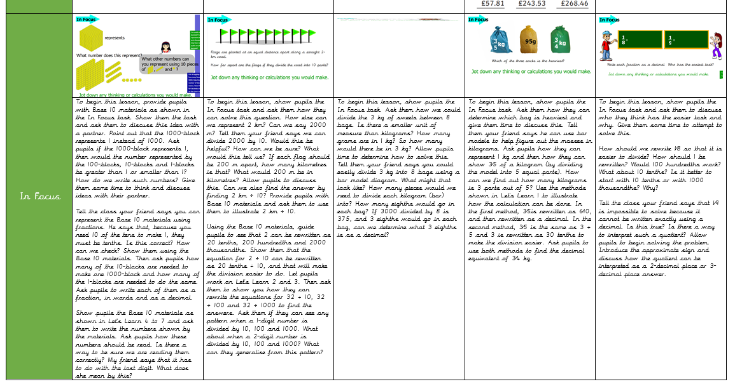
Lesson Structure
All lessons should have an In Focus, Guided Practice, Independent tasks, Problem Solving Opportunity and a Plenary.
This structure enables pupils to practice
Independent tasks are taken from Maths No Problem.

Slide 10
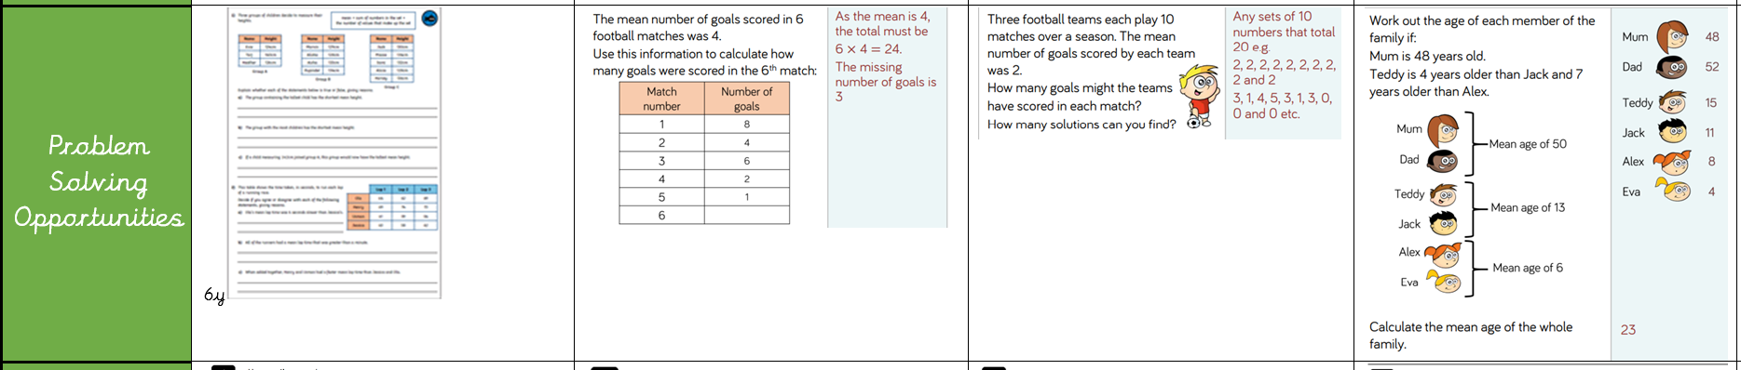
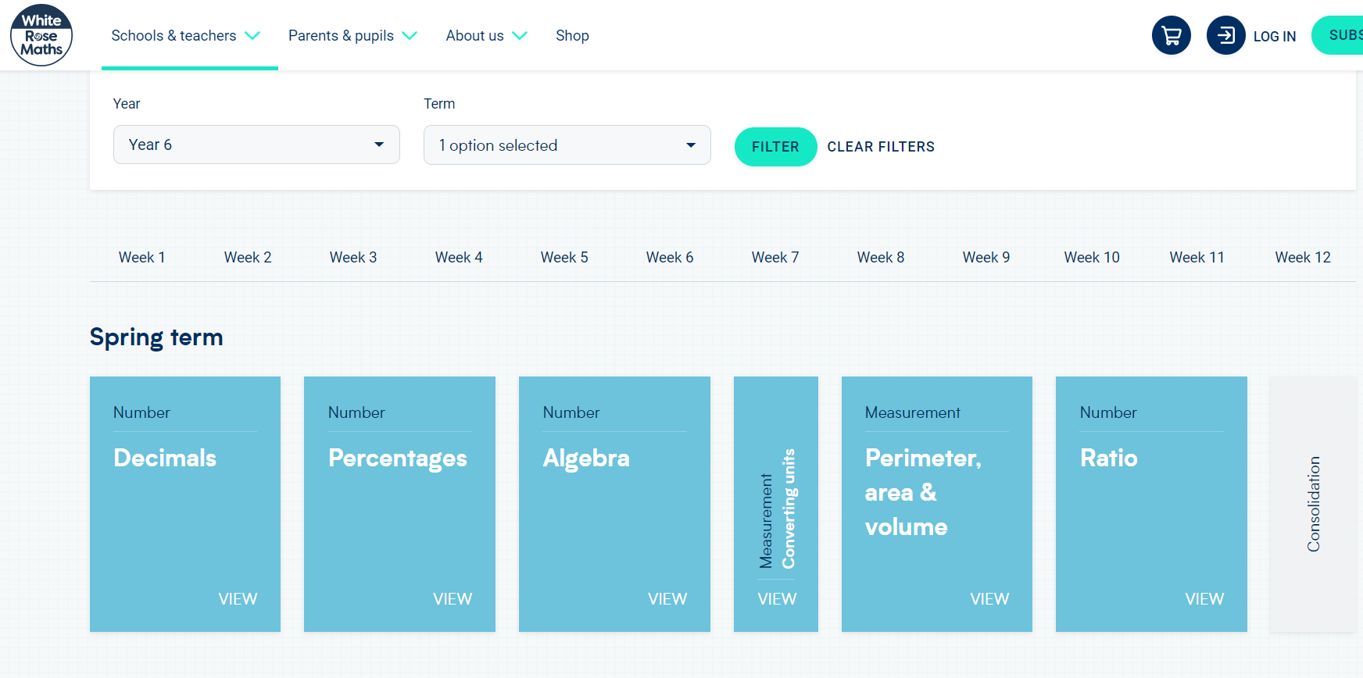
Problem Solving
Each lesson should have a Problem solving activity matched to the learning objective as closely as possible.
White Rose Schemes of Learning (SOL) are a good source of problems, click on the image to go to the website, though White Rose teaches in a different order to Maths No Problem so it is important to check that the problem uses skills or methods that the children have been taught.

Slide 11
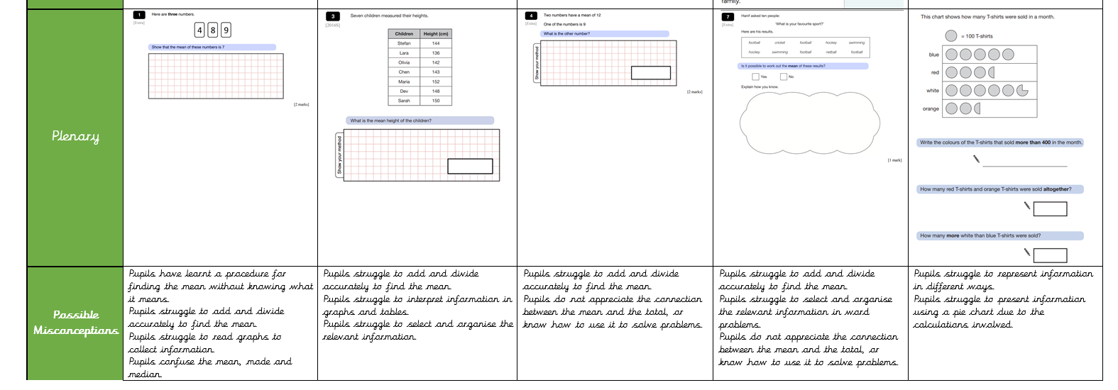
Plenary and Misconceptions
In Year 3, 4 and 5 a plenary can be an additional problem solving activity, an opportunity to discuss the independent problem solving or a question that presents the learning in a different way (such as from a PUMA test). In Year 6 we use the plenary to show a different SATs question each day.
Misconceptions should be identified from each stage of the lesson, based on the anticipated errors that pupils may make.

Slide 12
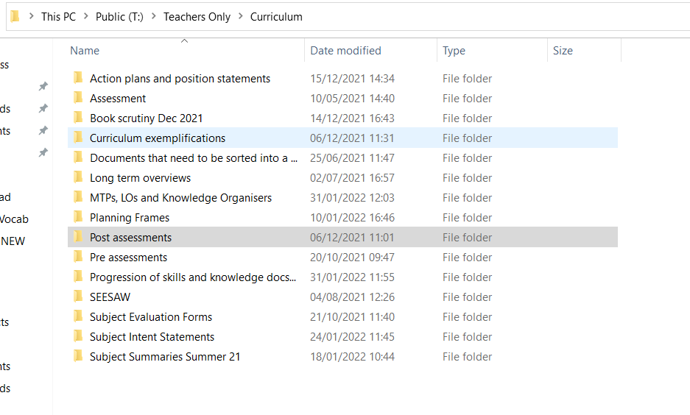
Pre and Post Assessments
These should be completed before, and at the end of, each unit. 3 or 4 key questions should be selected from the diagnostic tests saved on the system in the pre and post assessment folder.
The multiple choice options should be removed, to give the children the opportunity to show their working out.
These should be marked with the children and post assessments should be purple pen corrected.

