Slide 1
Parent Survey Responses
December 2024
62 responses in total

Slide 2
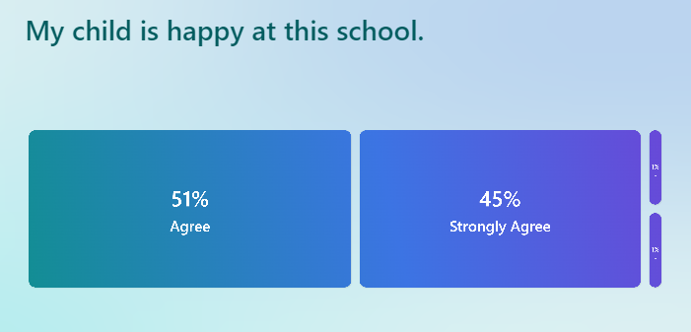
96% agree or strongly agree that their child feels safe in school.
This is an 11% increase.

Slide 3
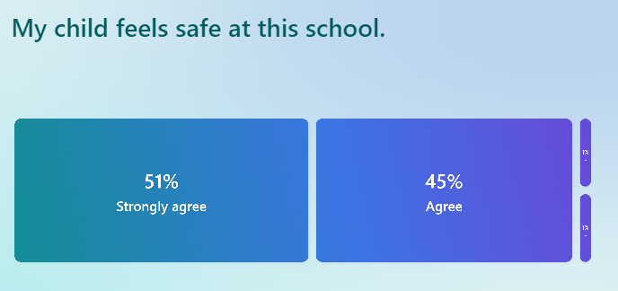
96% agree or strongly agree that their child feels safe in school.
This is a 7% increase.

Slide 4

83% agree or strongly agree that the school makes sure pupils are well behaved.
This is a 4% decrease, but 6% don’t know.

Slide 5
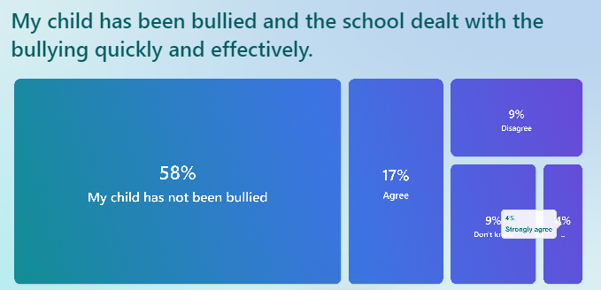
58% of parents feel their child has not been bullied. 21% felt it had been dealt with quickly and effectively. This totals 79%.
9% don’t know if their child has been bullied.
9% disagree.

Slide 6

94% agree or strongly agree (same as last year) that the school makes them aware of what their child will learn.

Slide 7

65% agree or strongly agree that concerns have been dealt with properly.
19% have not raised any concerns which was a new category.
Together this totals 84%.

Slide 8

79% agree or strongly agree that the school has high expectations.
12% don’t know.

Slide 9

95% agree or strongly agree that their child does well at this school.
This is a 1% increase.

Slide 10
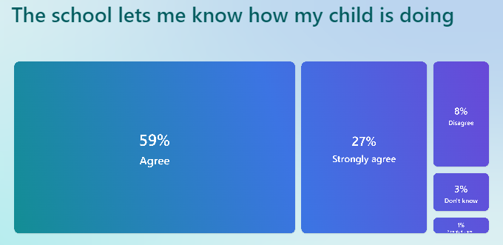
86% agree or strongly agree that the school lets them know how their child is doing.
This is an increase of 6%.

Slide 11

93% agree or strongly agree that there are a good range of subjects available.
This is a slight decrease of 4%.

Slide 12

96% agree or strongly agree that their child can take part in clubs or activities.
This is a 4% increase.

Slide 13

80% agree or strongly agree that the school supports their child’s wider personal development.
11% didn’t know (this is a 6% increase).
Overall a slight decrease of 5%.

Slide 14

93% would recommend the school to another parent.
This is a 6% increase.

